Slide 1
Monday Morning Teaching
Anatomy of the Inguinal and Femoral Canals
TEPP view of hernias
Mon 5th Mar 2012, 0700-0730hrs

Slide 2
Scope of Session
Spot Test (0700-0705hr)
Anatomy of Inguinal Canal (0705-0710hr)
Anatomy of Femoral Canal (0710-0715hr)
TEP Hernia (0715-0725hr)
What is TEP
TEP Anatomy
TEP Triangles
Triangle of Doom
Triangle of Pain
Mesh Anatomy in TEP
Questions / Discussions

Slide 3
Time Awareness Alert
This anatomy session scheduled 0700 – 0730hrs
In order for this session to finish at 0730hrs extended discussion regarding hernia’s will be limited.
Hernia’s
Aetiology
Types
Operative Techniques
Indications / Contraindications
Benefits / Superiority
Management of Recurrence etc…
Please direct at Fellowship contenders at a later time

Slide 4
Spot Test
Question
What are the muslces of the anterolateral abdomen
(5 in total)
Answer
External oblique
Internal oblique
Transversus abdominus
Rectus abdominus
Pyrimidalis
Question 1 0f 15

Slide 5
Spot Test
Question
What nerves supply Rectus abdominus and external oblique?
What nerves supply Internal oblique and transverus abdominus?
Answer
External oblique and Rectus by:
Lower intercostal and subcostal nerves T7-T12
Internal oblique and Transversus abdominus by:
T7-12 (as above) and
L1
Iliohypogastric
Ilioinguinal
Question 2 0f 15

Slide 6
Spot Test
Question
Which nerve supplies sensation to the root of penis and anterior 1/3rd scotum
Which nerve supplies the femoral triangle
Which nerve innervates the cremaster muscle ?
Answer
Ilioinguinal
Femoral branch (L1) of Genitofemoral nerve(L1/L2)
Genital branch (L2) of Genitofemoral nerve (L1/L2)
Question 3 0f 15

Slide 7
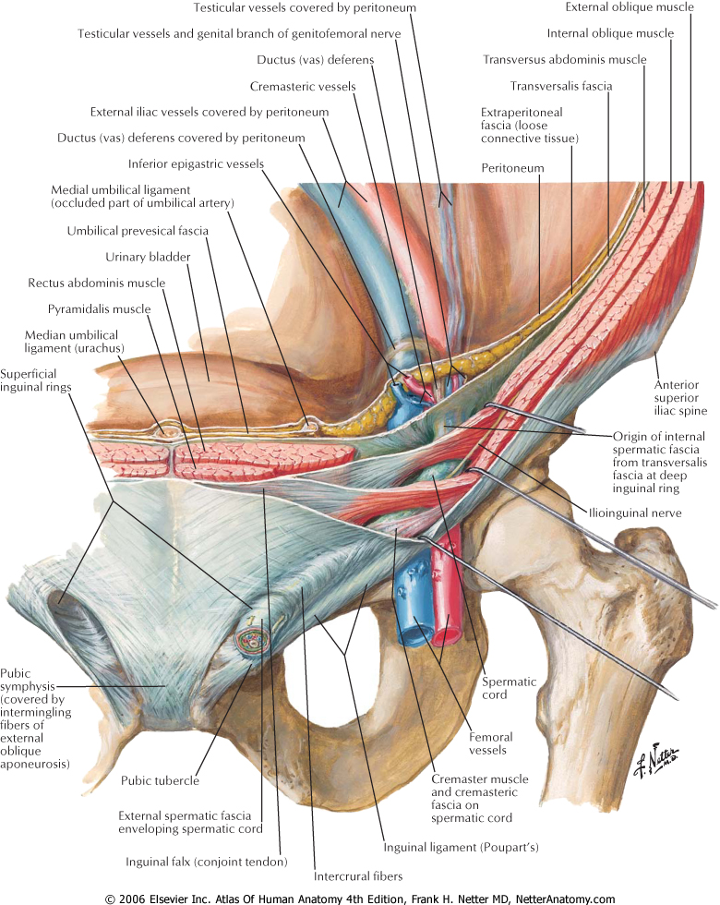
Spot Test
Question
What is the name of structure covered
Question 4 0f 15

Slide 8
Spot Test
Question
What is the name of structure covered
Question 4 0f 15

Slide 9
Spot Test
Question
What is the midinguinal point?
Name the structure for which the midinguinal point is a landmark?
Answer
½ way between PS and ASIS
Femoral artery
Question 5 0f 15

Slide 10
Spot Test
Question
What is the Midpoint of Inguinal Ligament?
Name the structure for which the midinguinal point is a landmark?
Answer
½ way between PT and ASIS
Deep inguinal ring
Question 6 0f 15

Slide 11
Spot Test
Question
What are the Boundaries of the Inguinal Canal?
Answer
Anterior – aponeurosis external oblique + (lat) internal oblique
Floor – inrolled edge ing lig supported med by lacunar lig
Roof – ↓ edges of IO + transversus, forms conj tend medially
Posterior – transversalis fascia(lat), conjoint tendon (med)
Question 7 0f 15

Slide 12
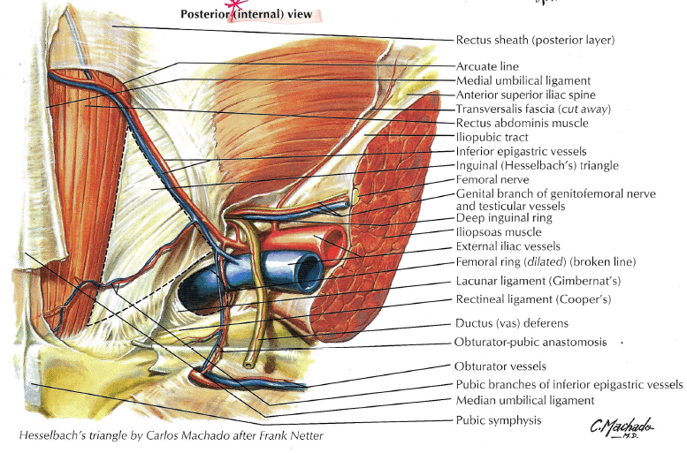
Spot Test
Question
What are the borders of the Femoral Ring?
Answer
Anterior – medial part of inguinal ligament
Lateral – femoral vein
Posterior – pectineal ligament and pectaneus
Medial – crescentic edge of lacunar ligament
Question 8 0f 15

Slide 13
Spot Test
Question
Internal oblique arises from how much of the inguinal ligament ? (also has wider origin)
Transversus Abdominus arises from how much of the inguinal ligament ? (also has wider origin)
Answer
Lateral 2/3rd of inguinal ligament
Lateral 1/3rd of inguinal ligament
Question 9 0f 15

Slide 14
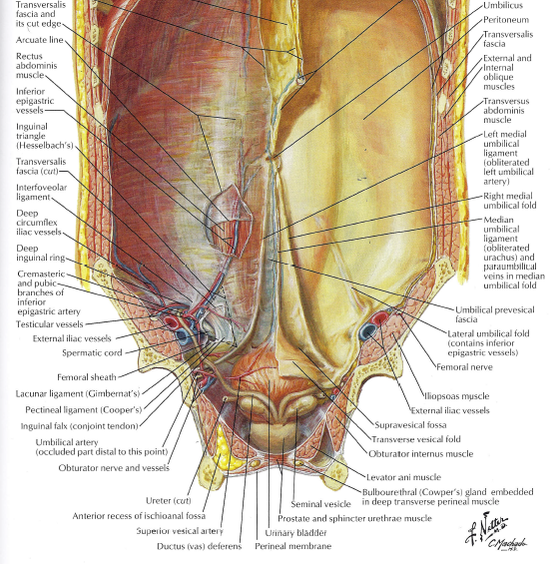
Spot Test
Question
Name the Umbilical Ligaments ?
Now their Contents?
Question 10 0f 15

Slide 15
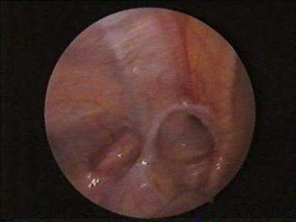
Spot Test
Question
What pathology does this intra-peritoneal image show?
Question 11 0f 15

Slide 16
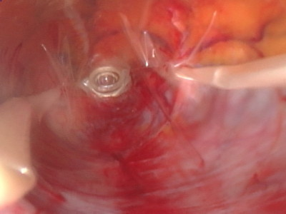
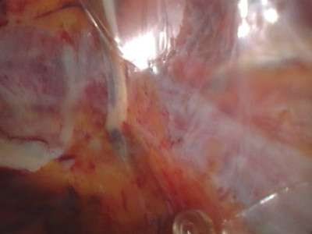
Spot Test
Question
This is direct vision whilst conducting balloon dissection in TEPP, what is the vessel most likely identified by marker?
Question 12 0f 15

Slide 17
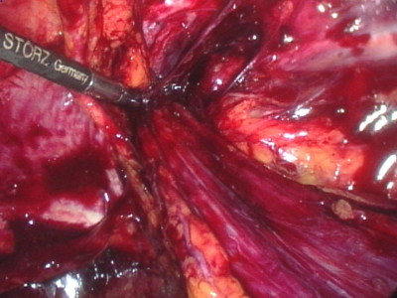
Spot Test
Question
If once the sac was dissected away and mesh inserted ready to be place, I fired an absorbatac in this triangle what structures could I hit?
Question 13 0f 15

Slide 18
Spot Test
Question
If once the sac was dissected away and mesh inserted ready to be place, I fired an absorbatac in this triangle what could be the patient experience in the long term
So what structure would I have hit?
Question 14 and 15 0f 15

Slide 19
Inguinal Canal

Slide 20
Inguinal Canal
Oblique intermuscular slit ~6cm, long lying above the medial ½ of inguinal lig.
Commences: Deep inguinal ring
Ends: Superficial Inguinal ring
Transmits:
Males: spermatic cord and ilioinguinal nerve
Females: round ligament of uterus and ilioinguinal nerve
Walls
Anterior – aponeurosis external oblique + (lat) internal oblique
Floor – inrolled edge ing lig supported med by lacunar lig
Roof – ↓ edges of IO + transversus, forms conj tend medially
Posterior – transversalis fascia(lat), conjoint tendon (med)

Slide 21
Inguinal Canal
Further Review of Associated Structures
Superficial Inguinal Ring
V-shaped opening in aponeurosis of ext. oblique
Lat. Crus attaches to pubic tubercle, some fibres reflect – posterior crus
Med. Crus attaches to pubic crest
Inter-crurual fibres form base of triangular opening and hold crus together
Deep Inguinal Ring
Opening in the trasnversalis fascia
Bounded
Laterally by the angle between transversus muscle fibres and inguinal ligament
Medially by thickened transversalis fascia named interfoveolar ligament
Note the transversalis fascia continues as internal spermatic fascia
Structures Deep to Posterior Wall
Deep inferior epigastric artery and vein
Lateral to deep inf. epigas. vessels – vas deferans or round ligament
Hasselbach Triangle (Inguinal Triangle)
Boundaries
Lateral: deep inferior epigastric artery
Medial: Lateral border of rectus muscle
Below: inguinal ligament

Slide 22
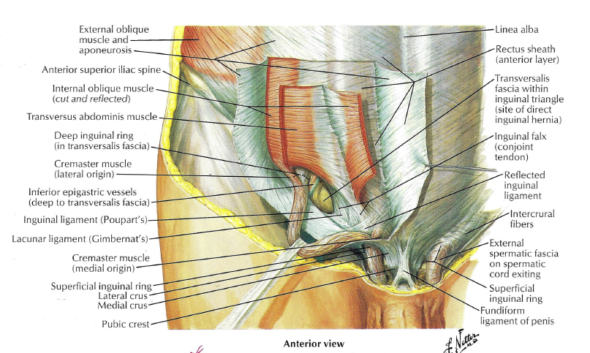

Slide 24
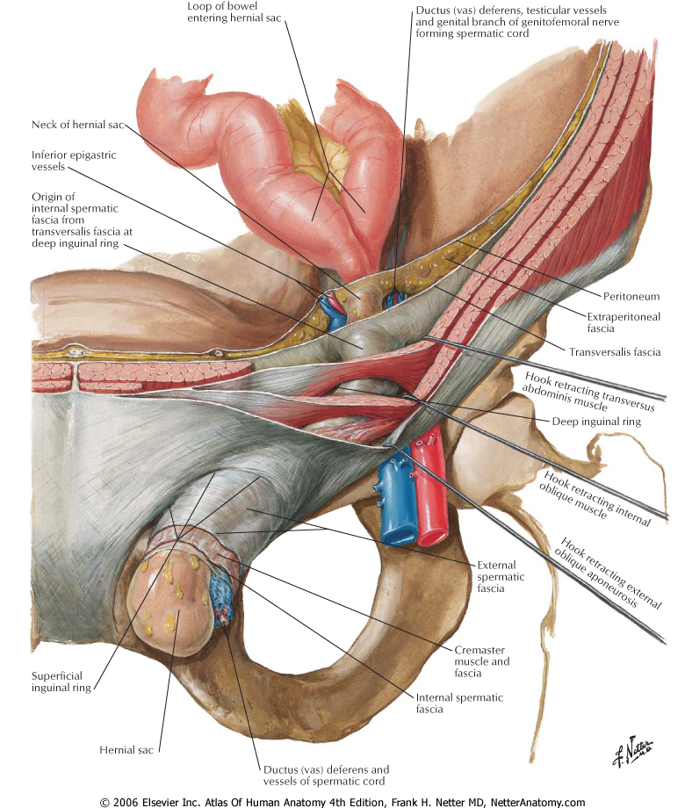

Slide 25
Femoral Canal

Slide 26
Femoral Canal
Femoral Ring
Is the Abdominal opening to the Femoral Canal
Boundaries:
Anterior – medial part of inguinal ligament
Lateral – femoral vein
Posterior – pectineal ligament and pectaneus
Medial – crescentic edge of lacunar ligament
Femoral Canal only about 1-2cm long before the walls fuse
Purpose
Route by which efferent lymph vessels from deep inguinal nodes pass to the abdomen
Allow space for femoral vein to expand
Contents:
Empty space
Fat
Lymphatics
Lymph node of Cloquet – drains clitoris/glans penis

Slide 27
Femoral Canal
Note
During open femoral hernia repair lacunar ligament may have to be incised – this puts an accessory obturator artery at risk
50% of people have an accessory or abnormal obturator artery
Accessary Obturator Artery:
Deep inferior epigastric gives a pubic branch to the periosteum of superior pubic ramus – this anastamoses with the pubic braches of obturator artery
If obturator artery absent – then this anastamosis is patent

Slide 29
Totally Extra Peritoneal (TEP)

Slide 30
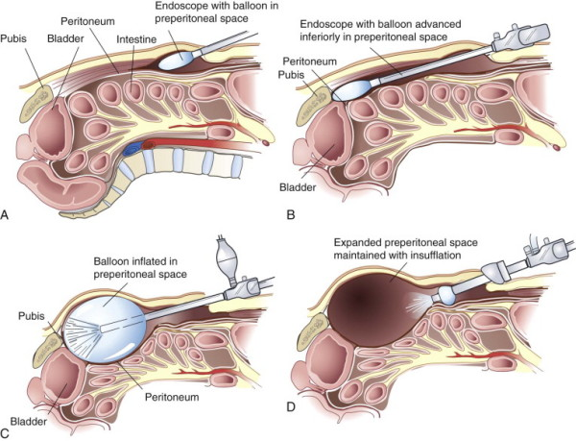
Totally Extra Peritoneal (TEP)
FIGURE 46-7 TEP laparoscopic hernia repair.
Townsend: Sabiston Textbook of Surgery, 19th ed , 2012

Slide 31
Posterior Aspect of Anterior Abdominal Wall

Slide 32
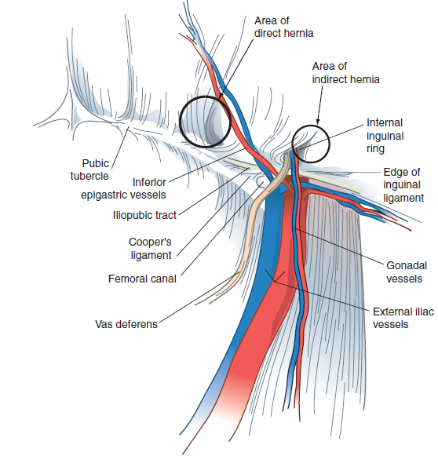
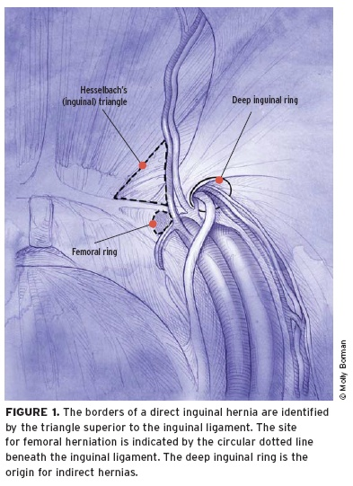
Anatomy in TEP Views
FIGURE 46-3 Townsend: Sabiston Textbook of Surgery, 19th ed , 2012

Slide 33
Intra Op Views - Anatomy in TEP
Dissecting Balloon inflation under vision in the pre-peritoneal space
Direct vision of deep inferior epigastric vessels staying above dissecting balloon
Images from www.bristolsurgery.com

Slide 34
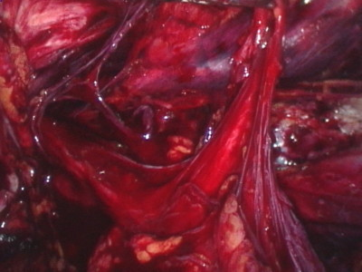
Intra Op Views - Anatomy in TEP
Identification of Sac and Anatomy in pre peritoneal space
Views post blunt dissection of sac off cord
Images from www.bristolsurgery.com

Slide 35
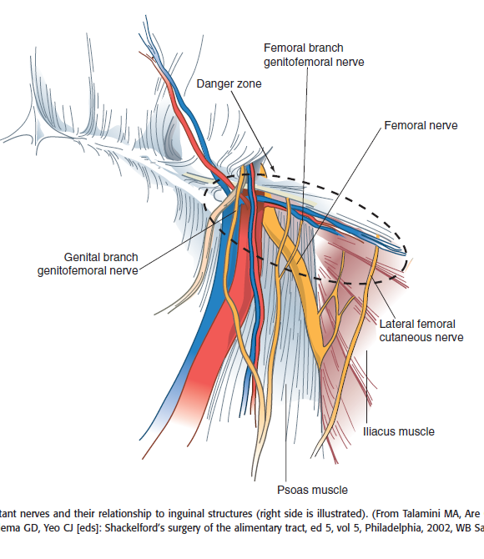
Stapling/Tacking Dangers in TEP
FIGURE 46-4 Townsend: Sabiston Textbook of Surgery, 19th ed , 2012

Slide 36
TEP Triangle of Doom
Staples / Tacking to be avoided
Bounded by:
Ductus deferens medially
Spermatic vessels laterally
Avoids injury to the external iliac vessels and femoral nerve.
FIGURE 46-4 Townsend: Sabiston Textbook of Surgery, 19th ed , 2012

Slide 37
TEP Triangle of Pain
Staples / Tacking to be avoided
Bounded by:
Iliopubic tract
External iliac artery
Avoids injury to the femoral branch of the genitofemoral nerve or lateral femoral cutaneous nerve.
FIGURE 46-4 Townsend: Sabiston Textbook of Surgery, 19th ed , 2012

Slide 38
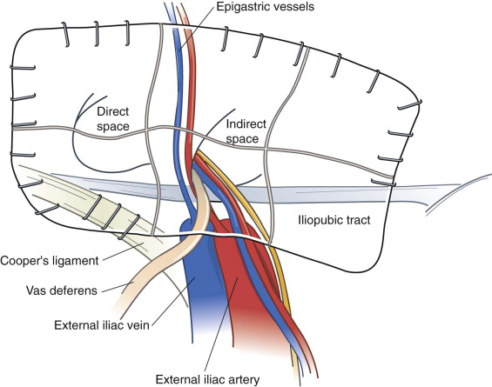
Mesh Anatomy in TEP Hernia Repair
FIGURE 46-8 Prosthetic mesh placement for TEP hernia repair
Townsend: Sabiston Textbook of Surgery, 19th ed , 2012

Slide 39
Thank you
Questions / Discussions

