Slide 1
Hernia repair
Rafael Gaszynski

Slide 2
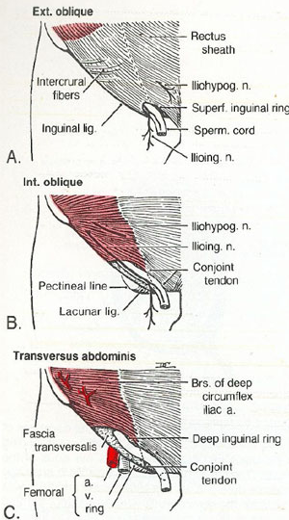
Anatomy

Slide 3
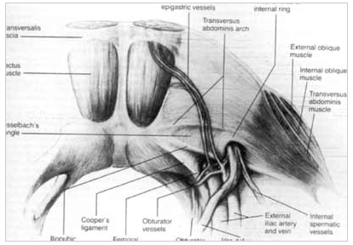
Anatomy

Slide 4
Hernias
Common problem
True incidence unknown
Suspected 5% population
75% of all hernias inguinal region
2/3 indirect
Men 25 x more then woman
Prevalence increases with age
Incarcerated
Strangulated – 1%-3% of groin hernias

Slide 5
Open Approach
Most common – Lichtenstein mesh repair
Tension free repair
Bassini – suture conjoint tendon to inguinal ligament
Shouldice - four layer reconstruction of fascia transversalis

Slide 6
Procedure
Consent, Time out, correct site, anbx, DVT
Surgeon on side of hernia, assistant opposite
Incision through skin, subcutaneous fat, aponeurosis of external oblique
Ilioinguinal nerve – protect or sacrifice
Find spermatic cord
Identify and separate the sac, open at the internal ring
Reduce contents of sac
Ligate and amputate the sac
Prepare mesh and fix to pubic tubercle – lower border of mesh can be fixed to inguinal ligament
Ensure tension free
Close in layers

Slide 7
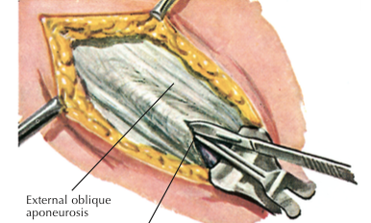
Mesh repair

Slide 8
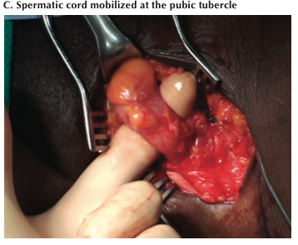

Slide 9
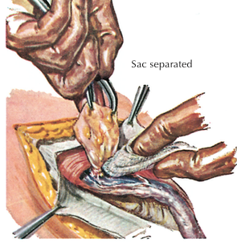

Slide 10
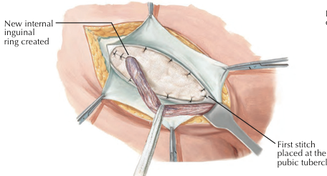

Slide 11
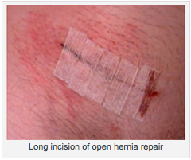

Slide 12
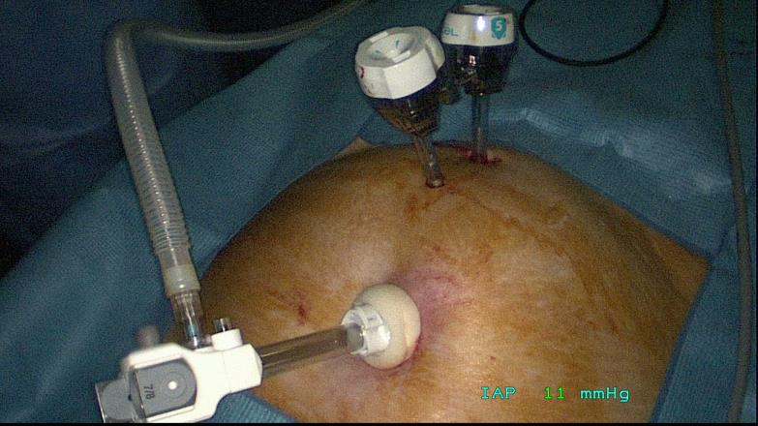
Laparoscopic Approach

Slide 13
Procedure
Consent, Time out, correct site, anbx, DVT
10mm infraumbilical incision
Expose the anterior rectus sheath and make an incision through it
Retract rectus muscle exposing anterior surface of posterior rectus sheath
Insert pre-peritoneal dissecting balloon into pre-peritoneal space
Advance to pubic symphasis and inflate balloon

Slide 14
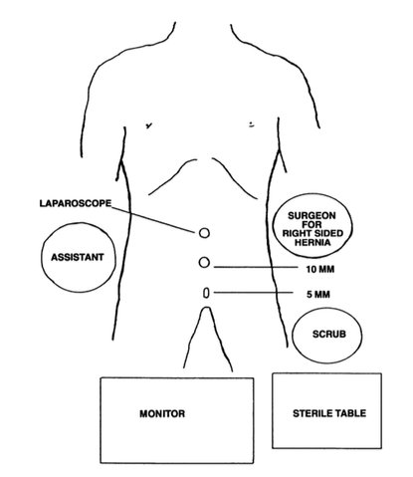
Position

Slide 15
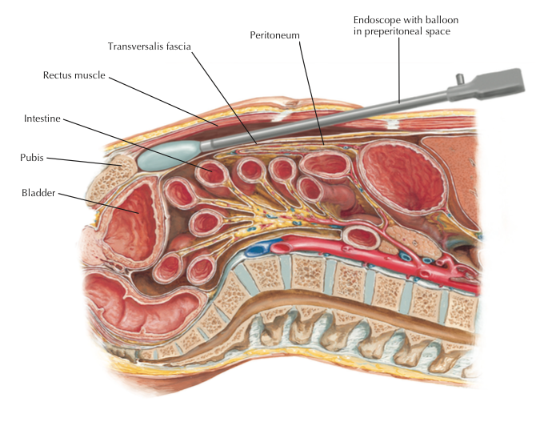

Slide 16
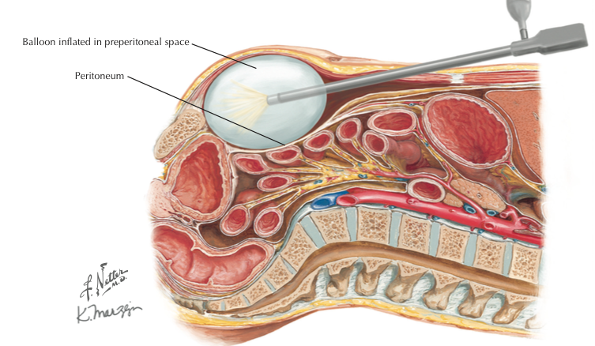

Slide 17
Procedure
Place laparoscope and insufflate pre-peritoneal space
Place 2x 5mm ports – usually in midline
Dissect and expose Hasselbach’s triangle
Dissect the preperitoneal space laterally and dorsally by pushing the peritoneum away from the abdominal wall
reduce the hernia by pulling it out of internal ring
Gonadal vessels and vas need to be protected
Insert mesh and tack into place
When tacking avoid the triangle of doom and pain
Desufflate the preperitoneal space and remove ports
Close anterior rectus sheath
Close skin incision ports

Slide 18
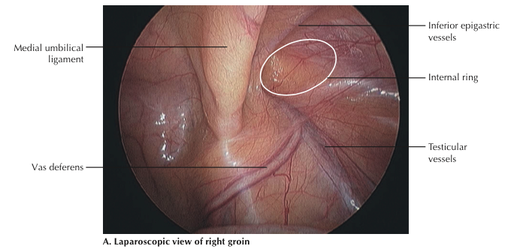

Slide 19
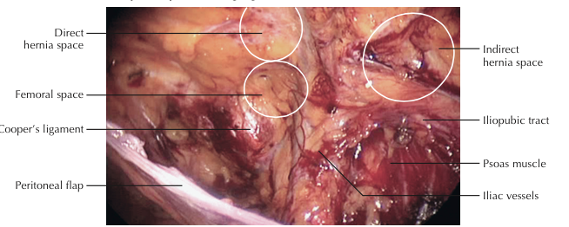

Slide 20
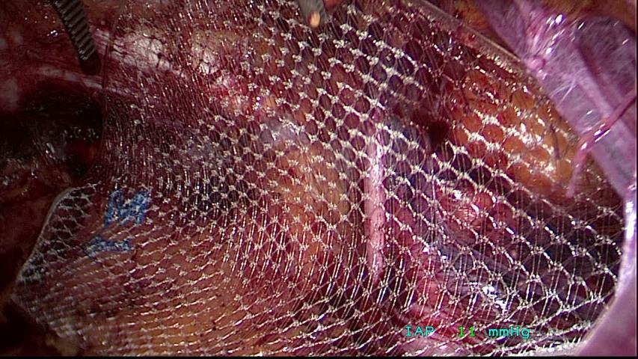

Slide 21
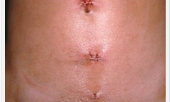
End

