Slide 1
Anal Fistula
What are the causes of fistula and what is Eisenhammer's theory?
What is Park's classification of anal fistula?
What are the options for managing fistula?

Slide 2
Why do we care?
Anal abscesses and fistulas are a common surgical problem
The majority share a common pathophysiology (primary cryptoglandular infection) but the resulting pathology is highly variable in the complexity with which the sphincter is involved¹
Simplest = infection of anal gland → perianal abscess that resolves after simple incision and drainage
Complex = suprasphincteric fistula with multiple tracks and cavities
No single procedure that reliably results in a high cure rate whilst preserving sphincter function¹
Notes:
that can only be completely identified and eliminated
after several examinations under anaesthetic, aided by endoanal
ultrasound or magnetic resonance imaging. In this latter category
of fistulae, the challenge of achieving long-term healing together
with preservation of sphincter function becomes more difficult

Slide 3
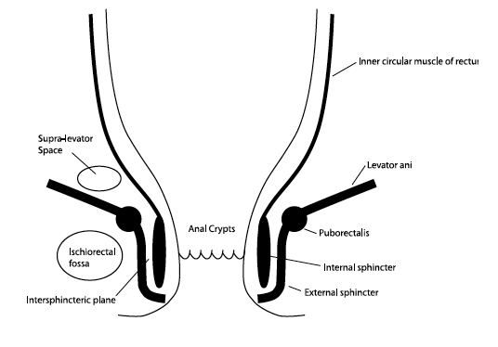
ANATOMY
External sphincter (ES) is a continuation of pelvic floor musculature²
Internal sphincter (IS) is a continuation of the inner circular muscle layer of the lower rectum²
Dentate line = site of anal valves
Proximal to each anal valve is a an anal crypt or sinus, anal glands empty into these crypts
Notes:
EUS: IS appears as hypoechoic ring, ES identified by identifying puborectalis sling at anorectal junction (hyperechoic and U-Shaped), ES commences when the open end of the U begins to close to form a complete ring of muscle
Mucocutaneous junction is the site of the dentate line (epithelium is columnar with goblet cells above, and stratified non-keratinised squamous epithelium with ATZ, cuboidal epithelium, of varying distance between)

Slide 4
AETIOLOGY
Cryptoglandular theory of Eisenhammer and Parks is widely accepted
Eisenhammer³
All non-specific abscess and fistulas are the result of extension of sepsis from an intramuscular gland, the sepsis being unable to drain spontaneously into the anal lumen because of infective obstruction of its connecting duct across the IS
Parks⁴
Should the initial abscess subside, the disease gland may become the seat of chronic infection with fistula formation

Slide 5
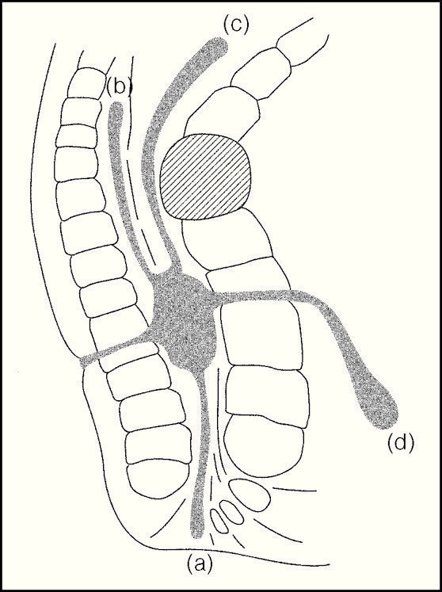
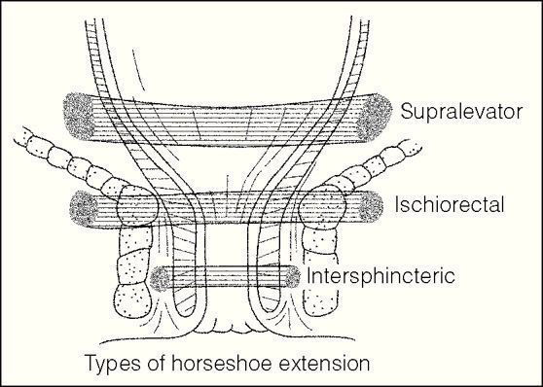
AETIOLOGY
Spread of sepsis can occur in 3 directions and circumferentially in any of the 3 planes
From Companion Series, originally from Parks et al.
Notes:
A = caudal → perianal abscess
B = cephalad → high intermuscular abscess
C = supralevator/pararectal
D = acress external sphincter → ischiorectal

Slide 6
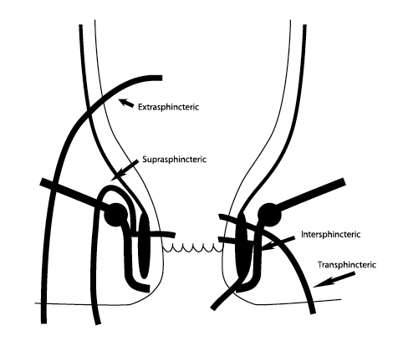
CLASSIFICATION OF ANAL FISTULA
The most widely used and taught is that devised by Sir Alan Parks at St Marks’ based on a study of 400 fistulas treated there
Crypotglandular hypothesis is central
Majority of fistulas arise from an abscess in the IS plane
The relationship of the primary track to the ES is paramount in surgical management and 4 main groups exist
Intersphincteric
Trans-sphincteric
Suprasphincteric
Extrasphincteric

Slide 7
ANORECTAL ABSCESS
Presentation
Local pain and swelling
Features depend on site
Management
Surgical drainage under GA (technique depends on location of abscess), incision parallel to the anal canal (less likely to cut through fibres of the ES)²
Should we look for an internal opening at time of drainage?
Prevelance of fistula formation after drainage of abscess is ~30%²
Notes:
Most evidence suggests that fistulas are present in the majority of cases of anorectal abscess formation, but many resolve spontaneously such that aggressive early identification and treatment may be unnecessary and lead to poorer outcomes

Slide 8
ASSESSMENT OF ANAL FISTULA
Goodsall and Miles outlined 5 essential points in the assessment of fistulas in 1900⁵
Location of the internal opening (IO)
Location of the external opening (EO)
Course of the primary track
Presence of secondary extensions
Presence of other diseases complication the fistula

Slide 9
ASSESSMENT OF ANAL FISTULA
Relative positions of IO and EO will indicate the likely course of the primary track
Presence of any palpable induration should alert you to a possible secondary track
Distance of EO from anal verge may assist in differentiating intersphincteric vs trans-sphincteric (greater distance = greater chance of complex cephalad extension)

Slide 10
Goodsall’s Rule
Notes:
Goodsall's rule generally applies in that the likely site of the internal opening
can be predicted by the position around the anal circumference of the external opening. Exceptions to this
rule include anteriorly located openings more than 3cm from the anal verge (which may be anterior
extensions of posterior horseshoe fistulas) and fistulas associated with other diseases, especially Crohn's and
malignancy
Predictive accuracy posterior 41-90% when put to the test, 49-72% anteriorly
Beware differential diagnosis: Hidradenitis suppurativa, TB, Bartholins, actinomycosis, anal fissure, ulceration with Crohns, STDs, low pilonidal sinus

Slide 11
Clinical Assessment
External opening is usually clear (at site of previous or spontaneous drainage)
Track may be felt between finger and thumb on DRE (note any clinical abnormalities of the anal sphincter)
If no abscess formation requiring drainage, further assessment with EUS or EUA²

Slide 12
Imaging
Endo-Anal Ultrasound
Cheap, “relatively easy”
Allows assessment of internal and external sphincter integrity
Operator dependent, limited focal range
MRI
Not cheap
No ionising radiation, able to image in any plane, high soft-tissue resolution
Very useful in Crohn’s
Fistulography
Inaccurate, unreliable, possible harmful

Slide 13
Other Investigations
Manometry
Assess sphincter function
EUA

Slide 14
TREATMENT OF ANAL FISTULA
Objectives of management (Finlay⁶)
Define anatomy of fistula
Drain associated sepsis
Eradicate fistula track
Prevent recurrence
Preserve continence and sphincter integrity

Slide 15
Lay-Open (Fistulotomy)
Best treatment in terms of absolute cure
Very high fistulas SHOULD NOT be laid open
Very low fistulas can be laid open without functional sequelae
Low and mid trans-sphincteric, what to do?

Slide 16
Fistulotomy
Lithotomy, Park anal or Hill-Ferguson retractor
Define track with blunt-ended probe
Tissue along probe is divided along entire length
Track curetted
Haemostasis
Recurrence 0-9%, disturbance in continence 0-33%

Slide 17
Seton
Thin silastic tubing or monofilament nonabsorbable nylon placed in track
“Holding position” to control sepsis while anatomy is investigated¹
Loose seton doesn’t ususally lead to permanent healing¹
Cutting seton creates a slow fistulotomy where there is sufficient time for fibrosis to prevent a defect in the sphincter (low recurrence, high reported incidence of incontinence)¹
Can be used long-term, preferred option in Crohn’s and recurrent fistulas

Slide 18
Advancement Flap
Only consider if a fistula cannot be laid open
Only when all sepsis has resolved
“Rectal advancement flap”
Full thickness flaps including mucosa and circular smooth muscle sutured over internal opening
Success rate varies 29-95% (realistic 60-70%)
Incontinence rates seem to be low

Slide 19
Fibrin Plug
Filling of the fistula track with a biological substance to encourage healing using fibrin glue of biological mesh
Encouraging results initially, long-term results not as encouraging

Slide 20
Conclusion
“Given the variability in the nature of fisulae, it is likely that no single procedure will be appropriate for all cases”¹
Most abscesses need to be drained
Most fistulas can be safely laid open without disturbance of continence
Usually clinically evident whether or not laying open is appropriate
“Mid level” fistulas should have radiological assessment of sphincter involvement
When multiple attempts have failed, a long-term seton may be the best option

Slide 21
References
The Authors Journal Compilation 2010 RACS
Rickard
S. Eisenhammer: The internal anal sphincter and the anorectal abscess. Surg Gynecol Obstet. 103, 1956, 501
Parks AG. The pathogenesis and treatment of fistula-in-ano. Br Med J; i: 463-9
Goodsall DH, Miles WE. Diseases of the Anus and Rectum. London: Longman, 1900

