Slide 1
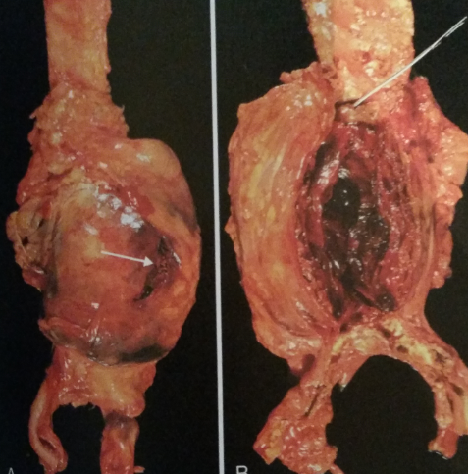
Aneurysms
Vascular Workshop, St George Hospital
Dr Daniel L Chan – Surgical Registrar

Slide 2
Questions
What is the pathogenesis of aortic aneurysms?
When should abdominal aortic aneurysms (AAAs) be repaired?
How are endoleaks classified?
What are the management options for peripheral aneurysms?
What are the merits of different graft materials?

Slide 3
Background
Definition
Derived from Greek ‘aneurysma’ meaning ‘a widening’
An arterial aneurysm is defined by localised increased vessel diameter of ≥50% of normal
AAA ≥ 3.0cm
Prevalence
AAAs occur in 7-8% of men over 65 years of age
Male : female = 6 : 1
Approx. 25-50% of patients with AAA have coexisting femoral or popliteal aneurysms

Slide 4
Classification
“True” – involves all three layers of arterial wall (intima, media, adventitia)
vs
“False” or pseudoaneurysm – extravascular haematoma that freely communications with the intravascular space
“Saccular” – spherical outpouchings
vs
“Fusiform” – diffuse, circumferential dilatation

Slide 5
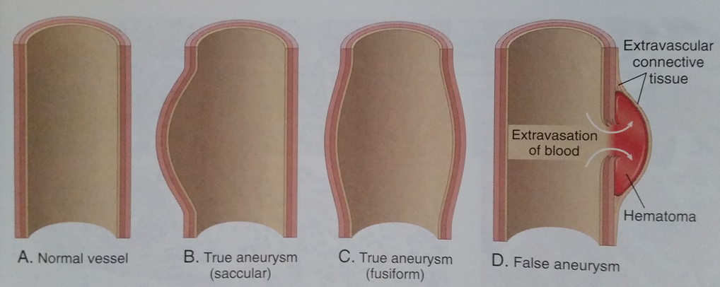

Slide 6
What is the pathogenesis of aortic aneurysms?
Altered balance of elastin and collagen degradation and synthesis mediated by local inflammatory infiltrates and destructive proteolytic enzymes they produce
Matrix metalloproteinases (MMPs), extracellular matrix degrading enzymes, production is locally increased
Tissue inhibitor of metalloproteinases (TIMP) is levels are reduced
Biochemical wall stressors – disturbed flow patterns, particular infrarenal aorta
Degenerative/Atherosclerosis (majority)
Intimal plaques → compress onto underlying media → compromise nutrient and waste diffusion → thinning and weakening of the media → degeneration and necrosis → vessel dilation
Inflammatory
Infection
Traumatic
Congenital
Notes:
In particular MMP-2 and MMP-9 are subtypes that appear most influential in AAA pathogenesis

Slide 7
Presentation
Majority are asymptomatic, incidental findings
Back pain
Compressive symptoms
Duodenal – N+V
Ureter – hydronephrosis
Ilio-caval – venous thrombosis
Rupture triad
Abdominal pain
Pulsatile mass
Hypotension

Slide 8
Investigations
Imaging
Ultrasound – screen and follow-up
CT angiogram
Arch to below knees
primary modality, define proximal/distal extent, iliac aa
Preoperative assessment (concomitant CAD +/- COPD)
ECG
CXR
TTE +/- stress study
Spirometry
As much optimisation as possible

Slide 9
When should AAAs be repaired?
The principle of AAA management is prevention of rupture
Mortality rate for elective vs emergency repair - ~2-5% vs 50-60%
Medical
Control of blood pressure, cholesterol, antiplatelet therapy, statin, smoking cessation
AAA rupture risk correlates to size
Current recommendation; AAA≥5.5cm
Inflammatory AAA

Slide 10
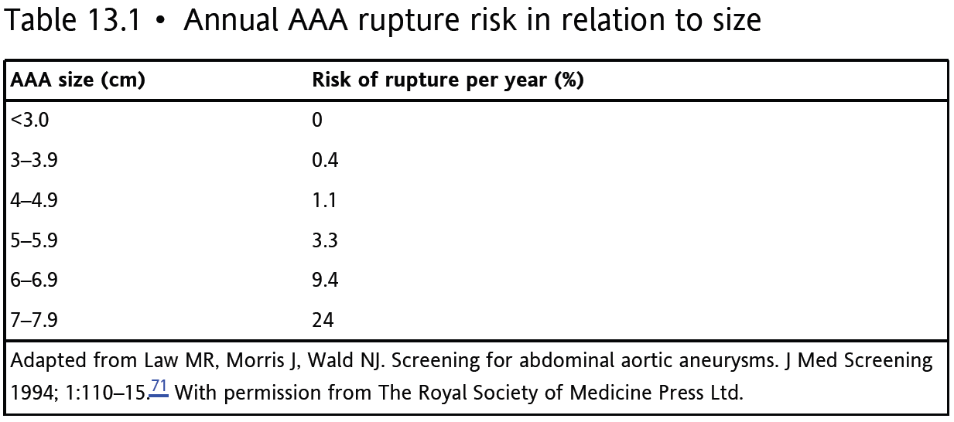

Slide 11
ADAM, UKSAT, CAESAR, PIVOTAL
Aneurysm Detection and Management trial (ADAM)
Prospective multi-centre RCT
1163 pts aged 50-79 with AAA>4cm randomised to early open surgery vs surveillance
No difference in long-term mortality
UK Small Aneurysm Trial (UKSAT)
Prospective multi-centre RCT
1090 pts aged 60-76 with AAA 4-5.5cm, randomised to early open surgery vs US surveillance until >5.5cm
No mortality benefit
?Endovascular surgery – European based - CAESAR 2011, USA based – PIVOTAL 2010
No benefit of early surgery for small aneurysms

Slide 12
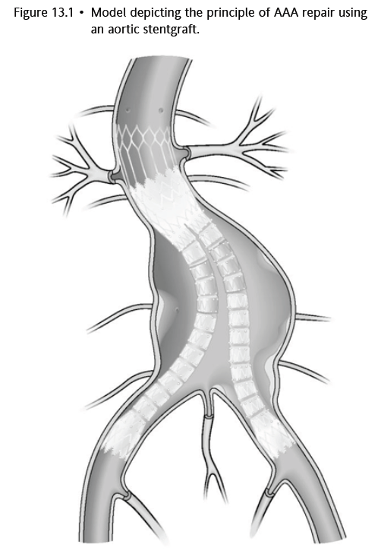
Endovascular AAA repair (EVAR)
First case reported by Parodi et al. 1991
Minimally invasive technique
Aims for sustained aneurysm exclusion from the systemic circulation via stentgraft

Slide 13
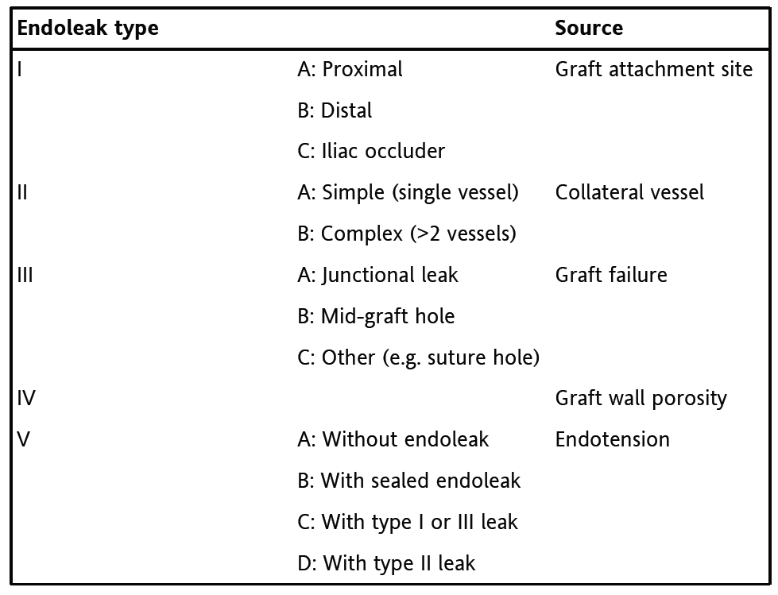
Endoleaks
Persistent blood flow outside the lumen of an endovascular graft but within an aneurysm sac or adjacent vascular segment being treated by the stent
Classification

Slide 14
Location
Aorta
Abdominal aorta - 62%
Aorto-iliac - ~15%
Thoracic aorta ~ 15%
Thoraco-abdominal – 2%
Isolated iliac - rare
Peripheral
Popliteal – 70-80%
Carotid – 4%
Femoral (false aneurysms, iatrogenic)
Visceral (rare)

Slide 15
What are the management options for peripheral aneurysms?
Location, size, symptomatic, thrombus/ occlusion
May rupture, throw emboli, cause ischemia, compressive symptoms
Management
Medical
Open surgical –primary repair, synthetic or autologous bypass graft, proximal + distal ligation, excision
Endovascular
Popliteal
Most common true peripheral aneurysms, but 15x less likely than AAA
If symptomatic or asymptomatic ≥2cm
Femoral
Common site of iatrogenic injury
If symptomatic, if ≥ 3cm
Psuedoaneurysms – US compression, thrombin injection

Slide 16
What are the merits of different graft materials?
Dacron – highly durable polyester thermoplastic polymer
ePTFE – flouropolymer, hydrophobic, mechanically durable, lower platelet deposition and complement activation
Both have similar patency rates
Considerations – handling characteristics, convenience, surgeon preference, cost
General practice Dacron for abdomen; PTFE for limbs

Slide 17
End

