Slide 1
Benign Breast Disease

Slide 2
Questions
What are the treatments for cyclical mastalgia?
What is the DDx of nipple discharge? How should this be managed?
What are phylloides tumours of the breast and how are they managed?

Slide 3
Assessment
Triple Assessment
Comprehensive history and examination
Imaging (mammogram +/- ultrasound)
Pathology (FNA or core biopsy)

Slide 4
Classification
Nonproliferative
Simple breast cysts
Papillary apocrine change
Epithelial-related calcifications
Mild hyperplasia of the usual type
Proliferative Lesions Without Atypia
Usual ductal hyperplasia
Intraductal papillomas
Multiple papillomas
Sclerosing adenosis
Radial scars
Simple fibroadenomas
Miscellaneous Lesions

Slide 5
Classification and Risk
Nonproliferative
Generally not associated with an increased risk of breast cancer
Most common lesions are breast cysts
Proliferative Lesions Without Atypia
Small increased risk of developing breast cancer, approximately 1.5-2 times that of the general population
Fibroadenomas only have increased risk of breast cancer if the fibroadenoma is complex, there is adjacent proliferative disease, or there is a family history of breast cancer

Slide 6
Cyclical Mastalgia

Slide 7
Breast Pain
Common in women
Usually due to normal physiological changes related to hormonal fluctuation
0.5-3.3% of women with pain only with have an associated cancer
2/3 cyclical
Usually associated to hormonal changes
1/3 noncyclical
More likely related to a breast or chest wall lesion

Slide 8
Cyclical Breast Pain
Begins during late luteal phase and dissipates with onset of menses
Caused by normal hormonal changes associated with ovulation that stimulate the proliferation of normal glandular breast tissue and result in pain
Oestrogen → ductal elements
Progresterone → stroma
Prolactin → ductal secretion
Can be associated with HRT or OCP use

Slide 9
Cyclical Mastalgia
More severe and persistent than normal cyclical breast pain

Slide 10
Noncyclical Breast Pain
Causes
Large breasts
?Diet and lifestyle
HRT
Ductal ectasia
Mastitis
Inflammatory breast cancer
Hidradenitis suppurativa
Pregnancy
Trauma
Medications

Slide 11
Clinical Evaluation
History
Examination
Diagnostic imaging
Targeted ultrasound most useful
+/- Biopsy
Exclude cancer

Slide 12
Treatment
Recommendations for treatment are based on data from observational or case-controlled studies, minimal or no data from RCTs
Diet and Lifestyle
Strong likelihood of placebo
Low fat, high complex carb diet
Elimination of caffiene
Vitamin E and evening primrose oil

Slide 13
Treatment
Symptomatic Relief
Well-fitting bra
Compresses
Medical Therapy
Paracetamol and NSAIDs
Topical NSAIDs
Reduction in dosing or discontinuing exogenous hormones
OCP can improve symptoms
Danazol
Tamoxifen
Bromocriptine

Slide 14
Nipple Discharge

Slide 15
One of the most commonly encountered breast complaints
50-80% of women in reproductive years can express one or more drops of fluid
6.8% of women referred to a surgeon because of symptoms of a breast disorder have nipple discharge
Most nipple discharge is of benign origin BUT malignancy MUST be excluded

Slide 16
History
Benign discharge is usually:
Bilateral
Multiductal
Occurs with breast manipulation
Cancer risk is higher when discharge is:
Spontaneous
Bloody
Unilateral
Uniductal
Associated with a breast mass
Woman > 40 years of age

Slide 17
Types of Nipple Discharge
Lactation
Physiologic
Usually bilateral milky discharge involving multiple ducts
Galactorrhoea (due to hyperprolactinaemia secondary to various causes)
Medication Related
Lactotroph stimulators and dopamine inhibitos
Neurogenic Stimulation
Chronic breast stimulation from manipulation or clothing → secretion of hypothalamic prolactin inhibitory factor → hyperprolactinaemia and galactorrhoea
Other Causes
Stress
Periductal mastitis
Duct ectasia
Notes:
Lactation – can last up to 6 months post delivery or cessation of breastfeeding, bloddy discharge in 20% of women in 2nd or 3rd trimester, usually benign

Slide 18
Pathologic Nipple Discharge
Unilateral, single duct, persistent, spontaneous, serous, sanguinous or serosanguinous
Causes
Papilloma (most common)
Malignancy (5-15%), most commonly DCIS

Slide 19
Clinical Evaluation
History
Examination
Skin changes and symmetry
Elicit discharge and identify duct
Lymphadenopathy
Breast masses
Tenderness

Slide 20
Diagnostic Evaluation
Imaging
Mammography
Ultrasound
Better at visualising ducts and nodules within them
Can be used for USS guided biopsy
MRI
Sensitive, role in evaluating nipple discharge is evolving
Cytology
Rarely helpful
No definite benefits
Skin punch biopsy
Particularly in women with “dermatitis” or “eczema” → BEWARE Pagets’ disease

Slide 21
Treatment
Physiologic Discharge
Make sure it’s not cancer
Think about stopping medications that may be causing it
Treat hyperprolactinaemia
Pathologic Nipple Discharge
Rule out cancer
Terminal duct excision (microdochectomy)
Total duct excision

Slide 22
Indications for Surgery
Spontaneous unilateral single duct discharge which is:
Bloodstained
Persistent (at least twice/week)
Associated with a mass (clinically or radiologically)
New serosanguinous discharge particularly in postmenopausal patient

Slide 23
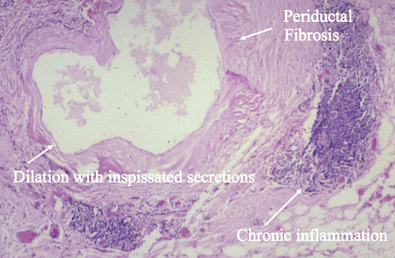
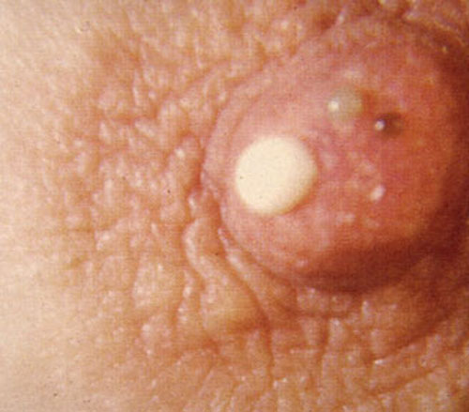
Common Pathology
Duct ectasia
Benign dilatation/shortening of terminal ducts → stasis of secretions → creamy/cheesy discharge

Slide 24
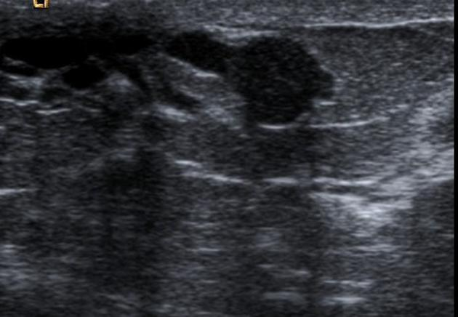
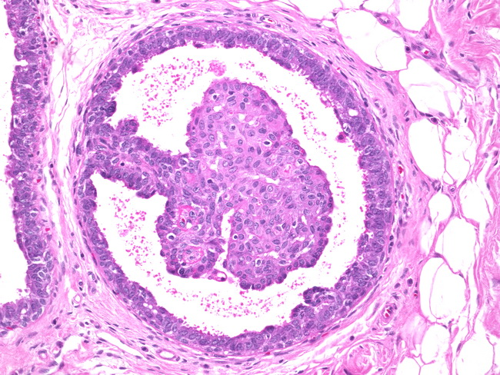
Common Pathology
Papillomas
Benign proliferative lesion in ductal system
“Keep bad company”
Risk of atypical hyperlasia or DCIS in nearby tissue

Slide 25
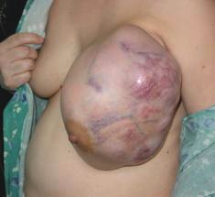
Phyllodes Tumours

Slide 26
What are they?
Uncommon fibroepithelial breast tumours capable of a diverse range of biologic behaviours
Benign fibroadenomas
Metastasise distantly and degenerate histologically into sarcomatous lesions
“Phyllodes” means leaf-like, typically describes papillary projections seen on pathological examination

Slide 27
Epidemiology and Risk Factors
Rare, 0.5% of all breast malignancies
Vast majority occur in women, age 42-45
Tumour grade increases with mean age at diagnosis
Li-Fraumeni is the only predisposing factor
Ongoing debate whether they arise from benign epithelial fibroadenomas

Slide 28
Presentation and Diagnosis
Presentation
Breast mass or abnormal mammographic finding
Examination
Smooth, multinodular, well-defined, firm mass, mobile and painless
May be slow or rapidly growing
Lymphadenopathy in up to 20% but lymphatic metastasis is rare

Slide 29
Presentation and Diagnosis
Imaging
Mammogram: Smooth, polylobulated mass resembling a fibroadenoma
Suspicion: large tumour, rapid growth
USS: Primarily solid, hypoechoic, well circumscribed, cystic areas may increase level of suspicion
MRI: Role unclear

Slide 30
Presentation and Diagnosis
Biopsy
FNAB associated with high false negative results and low overall accuracy
3 major cytological features: fibromyxoid stromal fragments with spindle nuclei, fibroblastic pavements, spindle cells of fibroblastic nature
Core Bx preferred method for diagnosis
Increased cellularity, mitosis, stromal overgrowth, fragmentation help differentiate between fibroadenomas and phyllodes
25-30% false negative rate
Indeterminate biopsy necessitates excisional biopsy

Slide 31
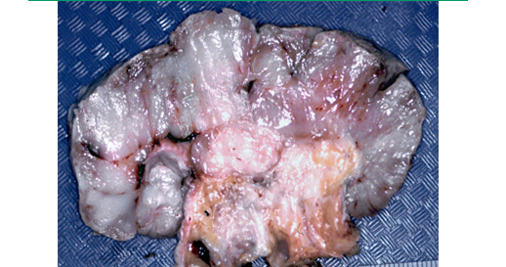
Pathology
Macroscopic
Round to oval multinodular masses with a grayish white appearance resembling a cauliflower
May be indistinguishable from fibroadenomas

Slide 32
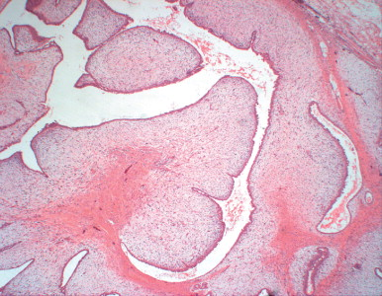
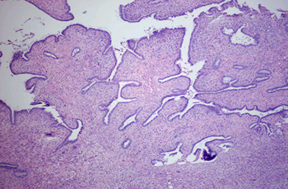
Pathology
Microscopic
Spectrum from benign fibroadenoma to a high-grade sarcoma
Characteristic leaf-like architecture consisting of elongated cleft-like spaces containing papillary projections of epithelial-lined stroma with varying degrees of hyperplasia and atypia
Stromal elements are a key component in differentiation of phyllodes tumours from fibroadenomas

Slide 33
Histological Classification
Classified as benign, borderline or malignant based on:
Degree of stromal cellular atypia
Mitotic activity
Infiltrative compared to circumscribed tumour margins
Presence or absence of stromal overgrowth
Benign
Increased stromal cellularity with mild to moderate cellular atypia, circumscribed tumour margins and low mitotic rate (<4/10HPF) and lack of stromal overgrowth
Borderline
Greater degree of stromal cellularity and atypia, mitotic rate 4-9/10HPF, microscopic infiltrative borders, lack of stromal overgrowth
Malignant
Marked stromal cellularity and atypia, infiltrative margins, high mitotic rate (>10/10HPF), presence of stromal overgrowth

Slide 34
Treatment
Surgery
Complete surgical excision is standard of care
Wide local excision with histologic margins negative for malignant cells
Breast conserving therapy is appropriate as long as adequate margins can be achieved (10mm)
Re-excision is indicated when necessary to ensure acceptable margins

Slide 35
Treatment
Local recurrence post wide excision
Benign 8%
Borderline and malignant 21-36%
Much higher rates if inappropriate margins

Slide 36
Treatment
Radiation
Adjuvant RT decreases local recurrences after breast conserving surgery with negative margins for borderline or malignant phyllodes tumours
Chemotherapy
Benefit of adjuvant chemotherapy is controversial
No randomised studies of adjuvant therapy
Consider in patients with a large (>5cm), high risk or recurrent malignant tumours

Slide 37
Treatment
Hormone Therapy
Not effective for phyllodes
Stromal component is the principle neoplastic cell population responsible for the metastatic behaviour

Slide 38
Prognosis
Majority of patients with benign and borderline phyllodes tumours are cured with surgery
Survival rate for malignant phyllodes tumours reported as 60-80% at 5 years

Slide 39
Advanced and Recurrent Disease
Local recurrence
Typically within 2 years of excision
Best treated with re-excision with wide margins or MST followed by RT
Metastatic disease
13-40%
Most frequently involve lungs
Survival mean 30 months after development of metastases
If unresectable, consider chemotherapy based on soft tissue sarcoma guidelines

Slide 40
Surveillance
No evidence based guidelines
Suggestions
History, examination and CXR every 6 months for 2 years, then annually
Resume surveillance mammography annually
Patients at high risk for metastatic disease, surveillance should be more frequent
?use NCCN soft tissue sarcoma surveillance guidelines

