Slide 1
Pancreatitis
James Bain
May 2014
1. What are the grading systems for Pancreatitis?
2. What is the role of surgery in acute pancreatitis?
3. What the principles of managing chronic pancreatitis?

Slide 2
Overview
The Pancreas
Pancreatitis
Signs + Symptoms
Investigations
Grading Systems
Role of Surgery
Management of Chronic Pancreatitis
Summary

Slide 3
Pancreas - Macroscopic
12-15cm long, J shaped organ
Lies transversely retroperitoneal at level L1/2
Embryology – two buds from endoderm of foregut
Ventral and dorsal bud forming uncinate and body
Secretes 1.5-3L per day – alkaline fluid
Exocrine - acinar cells – proteolytic, lipolitic, amiolytic
Endocrine - islets of Langerhans
Insulin
Glucagon
Somatostatic
Pancreatic polypeptide
Notes:
Had a body and tail – roughly 50% each – which lie in the lesser sac
Boders are D1 and 2 lateral and superior, D3 inferior, the stomach anterior and the Transverse mesocolon is attached to anterior portion of pancreas
Pancreas lies in C loop of duodenum with L renal vein posterior
CBD joins main pancreatic duct
Blood supply
coeliac trunk – Common hepatic→ gastroduodenal artery → superior pancreatoduodenal artery
SMA → inferior pancreatoduodenal atery
Coeliac trunk → splenic artery → branches to pancreas

Slide 4
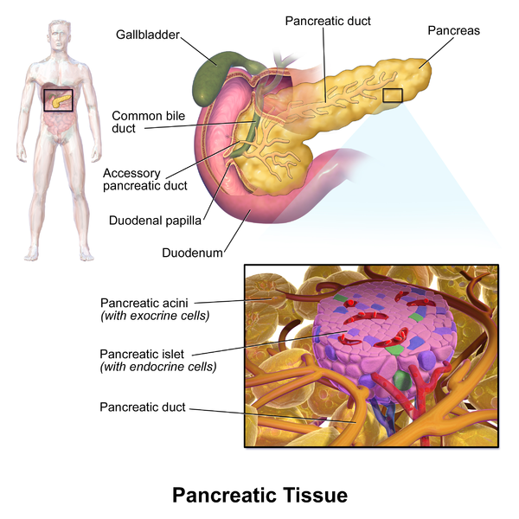
Islets of Langehans
α - glucagon
β - insulin
Δ - somatostatin
PP
ε - ghrehlin
Acinar Cells
Zymogen granules
Notes:
Islets of Langerhans
Alpha – glucagon – increase BSL – sugar metabolism – gluconeogenesis + glycogenolysis
catabolic
Beta – insulin – BSL uptake in adipose and skeletal muscle, glycogen synthesis in liver, lipids → Trigs, decreased lipolysis and proteolysis
Anabolic in general – inhibits alpha
Delta – somatostatin –- decreases gastric secretions and emptying. Decreases smooth muscle contractions . Decreases TSH, Prl, GH, from Ant Pit
also gastrin, secretin, CCK from stomach
is inhibitory
PP cells – pancreatic polypeptide – self regulates pancreatic secretion
Epsilon cells – ghrehlin – hunger hormone
Acinar cells – intercalated ducts with zymogen granules- amylase, lipase, cholesterol esterase, endopeptidases (trypsin and chymotrypsin), exopeptidases (carboxypeptidase + aminopeptidases)
Proteolytic enzymes packed as zymogens
Enterokinase cleaves tripsinogen into trypsin which when activates other enzymes –

Slide 5
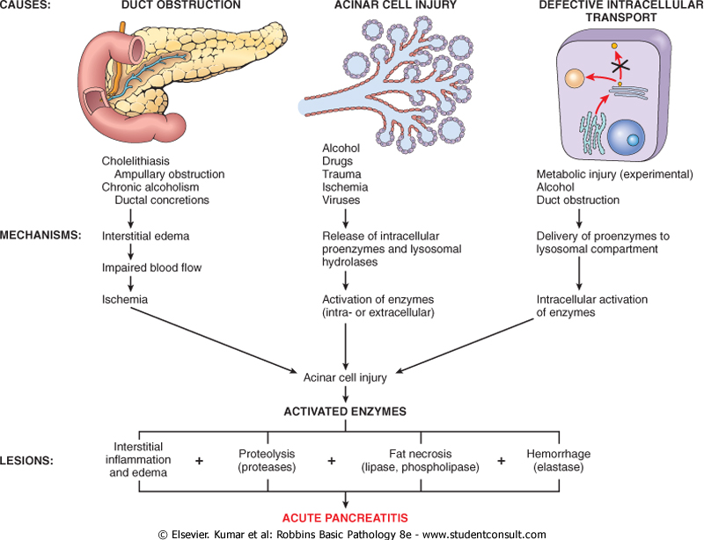
Notes:
35% ETOH and Gallstones
Incidence 15-40/100 000
5-10% is severe
Mortality 5%
intercalated ducts with zymogen granules- amylase, lipase, cholesterol esterase, endopeptidases (trypsin and chymotrypsin), exopeptidases (carboxypeptidase + aminopeptidases)
Proteolytic enzymes packed as zymogens
Enterokinase cleaves tripsinogen into trypsin which when activates other enzymes
Activatation of trypsin in pancreatic tissue

Slide 6
Pancreatitis - Signs and Symptoms
Epigastric pain – constant, classically radiating to back
Tachycardia, fever, jaundice, shock
Nausea, vomiting, abdominal distension
SOB + Hypoxia
Flank bruising – Grey-turners
Periumbilical bruising – Cullens
What is your differential Diagnosis?DDx
Perforated Viscous
AAA
Cholecystitis
Cardiac
Gastritis
Ischaemic bowel
Notes:
Jaundice from oedema of pancreas and compression of intrahepatic part of CBD
Cullens and grey-turners presence suggest a severity of illness
AAA
Cholecystitis
Ruptured spleen
Ruptured liver
Cardiac
Gastritis

Slide 7
Pancreatitis Workup
History / Aetiology
Investigations
Gallstones
Ethanol
Trauma
Steroids
Mumps / Metabolic
Autoimmune
Scorpions
Hyperlipidaemia, Hyperthermia
ERCP + emboli
Drugs
FBC
UEC + CMP
LFTs
Amylase
Lipase
Ca 19.9, fasting lipids
US
CT - timing
MRCP / CT cholangiogram
ERCP
EUS
Notes:
Lipase 3 x upper limit = 100 → NO correlation between level and severity
Serum lipase is more sensitive and specific as salivery serum amylase may be elevated in DKA or other acidaemias
CRP <200 suggestive of necrosis
CT – good for duct dilatation, degree of necrosis, SBO
- best utilised at day 3
MCRP – allows to see difference between neoplastic lesions and inflammatory
- non-invasive imaging of pancreatic duct
ERCP – diagnosic and therapeutic – pts will have elevated lipase / amylase but need pain for diagnosis
Amylase will fall within 24-48 hrs – Lipase more sensitive but takes longer to rise
Tests of pancreatic function – faecal elastase

Slide 8
Ranson’s
11 parameter’s (both at admission and at 48hrs)
Admission
–Age>55, WCC >16, LDH >600, Glucose >10, AST >120
48 hrs
–Haemotcrit fall >10%,
- BUN >1.8mmol/L despite fluids,
- Serum calcium < 2mmol/L,
- PaO2 <60mmHg,
- Base deficit > 4mEq/L,
- Fluid Sequestration of >6L
Score-
<3 mild (mortality is <1%),
3-5 (15% mortality,
> 5 (mortality 40%)
>6 (mortality >90%)
But this score is a poor predictor of severity, other limitation only used once and in 48 hrs and only in alcoholic
Notes:
Developed 1978

Slide 9
Aetiology
Ideopathic
Gallstones / Mechanical Obstruction – 38%
Congenital malformations, cancer
Size of Gallstone - 5mm
Ethanol – 35%
Trauma – 1.5%
Steroids
Mumps / Metabolic
CF, hereditary pancreatitis
Autoimmune
Sjogrens
Scorpions
Hypertriglyceridaemia 3%
Trigs >10
ERCP – 5% + emboli
Drugs 2-5%
Sulphonamides, azathioprine, thiazides, frusemide, oestrogens, valproic acid, 6-mecaptopurine, tetracylines, ART
Notes:
4x more likely to have pancreatitis with stones less than 5mm

Slide 10
What are the grading systems for Pancreatitis?
Ranson’s
Apache II – acute physiology and chronic health evaluation
Modified Glasgow
Organ Failure
Balthazar - CT criteria
Notes:
Ransons
Atlanta
Number of classification systems of severity were proposed at the international symposium on pancreatitis in 1992

Slide 11
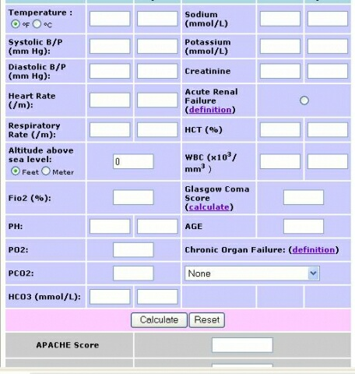
Apache II
1.Age
2.Temperature (rectal)
3.Mean arterial pressure
4.pH arterial
5.Heart rate
6.Respiratory rate
7.Sodium (serum)
8.Potassium (serum)
9.Creatinine
10.Hematocrit
11.White blood cell count
12.Glasgow Coma Scale

Slide 12
Modified Glasgow
PaO2 <80 mmHg
Age >55
Neutrophils – WCC >15
Calcium <2mM
Renal Fn – urea >16mM
Enzymes – LDH >600, AST > 200
Albumin <32
Sugar >10mM
3 or more suggest severe pancreatitis and should be managed in ICU
Validated for Alcohol and Gallstone pancreatitis

Slide 13
Organ Failure
Organ Failure
Bedside index of severity in acute pancreatitis (BISAP)
SBP < 90mmHg
Pao2 <60mmHg
Creatinine >180 uM
GI bleeding
SIRS
Temp >38, <36
Pulse >90
Tachypnnoea >24
WCC >12
BUN >8
Impaired mental status
SIRS 2/4
Age >60
Pleural Effusion
Multi organ system score (MOSS)
CRP >150
Notes:
Multi Organ Systems Score (MOSS)

Slide 14
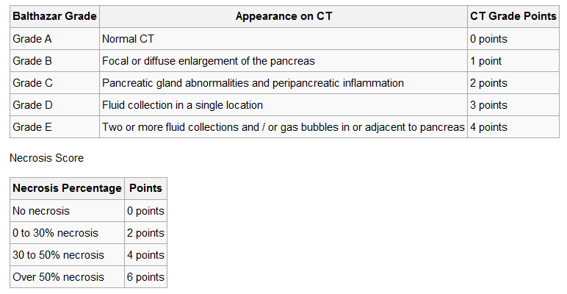
CT
Mortality
0-3 = 3%
4-6 = 6%
7-10 = 17%
Notes:
Developed 1990
Outlines the difference between necrotising and interstitial pancreatitis

Slide 15
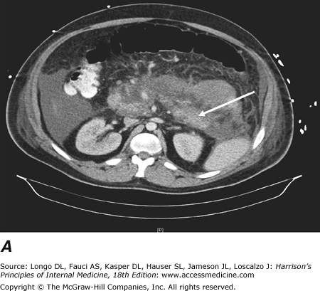
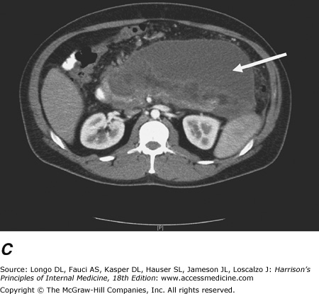
Notes:
Acute necrotizing pancreatitis: CT scan. Contrast-enhanced CT scan showing acute pancreatitis with necrosis. Arrow shows partially enhancing body/tail of pancreas surrounded by fluid with decreased enhancement in the neck/body of the pancreas

Slide 16
What is the role of surgery in acute pancreatitis?
Correct Diagnosis
ERCP
Step up approach - Percutaneous drainage
Partial pancreatectomy / necrosectomy
Notes:
Only 10% of hospitalised patients have necrotising pancreatitis

Slide 17
Diagnosis
Severity
CT
Dynamic CT 3-5 days predicts severity + degree of necrosis
Interstitial vs necrotic
Sterile vs. infected necrosis
Need cultures day 7-10
Empirical antibiotics for fever not indicated unless cultures positive
Walled off necrosis / Pseudocysts
Notes:
Necrosis will not become infected until day 7-10 → diagnosis can be done by CT guided aspiration
Clinically will have persistent fever, raised WCC, and organ failure in patient with infected necrosis
Dynamic – IV + PO contrast
Walled off necrosis and pseudocysts develop later in course of pancreatitis.
Many Pseudocysts resolve spontaneously – rupture can have catastrophic outcomes
Walled off necrosis differs by pancreas appears necrotic an heterogenous on CT whereas pseudocyst the pancreas appears enhancing with cyst distinct

Slide 18
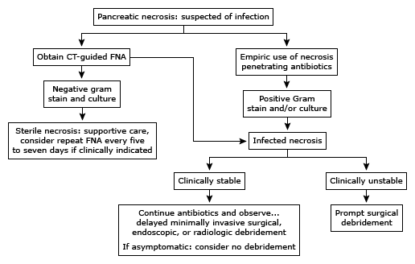
Notes:
Pending region
Local practices and surgeon preference

Slide 19
Endoscopic surgery - ERCP
Pts severe gallstone pancreatitis are candidates suitable for ERCP
Should be offered in first 72 hrs
Done urgently with known or suspected ongoing obstruction and organ failure
Cocharane review suggest only indicated in severe cases or obstructive LFTs and clinical concern.
Balloon + Sphincterotomy

Slide 20
Necrosectomy
Step up approach
Percutaneous drainage
Laparoscopic
Laparotomy
Necrotising pancreatitis is associated with 8-39% mortality
Secondary infection resulting in sepsis and MOF results in 100% mortality if untreated
Open necrosectomy is the traditional approach
Associated with high complication (34-95%) and mortality (11-39%) risk

Slide 21
Necrosectomy
Disclaimer
Open – midline laparotomy
Allows inspection of the abdomen
Gastrocolic ligament divided to enter lesser sac
Blunt debridement
Can pack the cavity, staged repeat laparotomy, continuous lavage, suction
Laparoscopic
Transperitoneal – hepatogastric, gastrocolic, transverse mesocolon approach
Retroperitoneal
Endoscopic
Transgastric
Gardner et al Gastrointest Endosc 2011 – 104 patients, 91% success, 14% complication, 5 deaths, 3 open
Better outcomes with delayed surgery until necrosis has organised approx 3-4 weeks post presentation/onset of symptoms.
Better demarcation, less bleeding
Notes:
Van Santvoort HC et al; Early endoscopic retrograde cholangiopancreatography in predicted severe acute biliary pancreatitis: a prospective multicentre study. Ann Surg 2009
Van Santvoort HC et a;l A step-up approach or open necrosectomy for necrotizing pancreatitis. N Eng J Med 2010

Slide 23
What the principles of managing chronic pancreatitis?
Diagnosis
Prevention
Pain
Nutritional deficits and Pancreatic insufficiency
Management of complications with Surgery

Slide 24
Background
25% of Patients develop recurrent attacks
Gallstones and ETOH adults
CFTR gene in kids
Histological – Chronic inflammation, fibrosis, destruction exocrine and endocrine tissue
Notes:
Cystic fibrosis transmembrane receptor gene – chloride channel

Slide 25
Diagnosis
Signs and symptoms
Abdominal pain
Steatorrhoea
Wt loss
DM
Serology – endo and exocrine fn
Imaging
CT, MRCP, EUS, ERCP
Notes:
CT - dilated ducts, calcification, atrophic pancreas, pseudocysts
ERCP – Chronic pancretitis – 1) luminal narrowing, 2) irregularities in duct system → stenosis, dilation, sacculation, ectasia, 3) Blockage of panceratic duct by calcium deposits
EUS – very sensitive at showing pancreatic parenchyma
Impaired glucose tolerance
Fecal elastase
Secretin stimulation test
Need 60% fn to be lost

Slide 26
Prevention is better than cure
Ceasing ETOH
Counselling
AA
Disulfiram
Cholecystectomy
Stone size
Cholangiogram
Medications

Slide 27
Pain
Treat on a PRN basis not regular for ‘flares’
Short term burst of NSAID, Amitriptyline and Opioid beneficial
Chronic pain clinic
Psychologist

Slide 28
Pancreatic insufficiency
Food fear
Impaired glucose tolerance
Enzyme supplementation – Creon
Data suggests need 80,000-100,000 units lipase per meal.
Formulation | Lipase | Protease | Amylase
Creon 6 | 6,000 | 19,000 | 30,000
Creon 12 | 12,000 | 38,000 | 60,000
Creon 24 | 24,000 | 76,000 | 120,000

Slide 29
Surgery
Decompression
Denervation
Resection
ERCP – stenting, sphincterotomy
pancreatico-jejunostomy (Puestow) -if pancreatic duct is distended / head involved
ESWL *
Thoracoscopic denervation needs further studies to validate
subtotal panceatectomy -if duct is not distended / tail involved
Whipples
Frey’s Procedure – cores out head
Notes:
Pancreatic stones found in 20-60% of patients with chronic pancreatitis – Up to date
Journal of pancreas

Slide 30
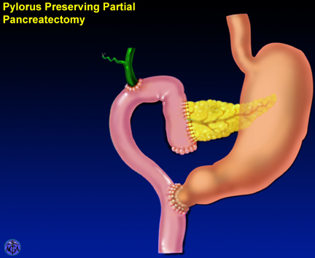
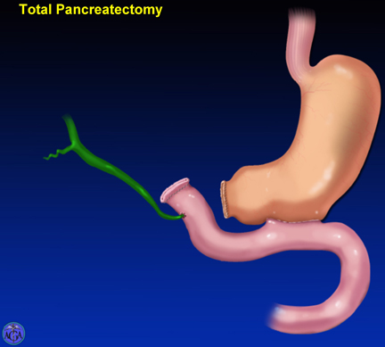

Slide 31
Other Complications
Narcotic addiction
Gastroparesis
B12 malabsorption
GI bleeding
Jaundice
Cholangitis
Pseudocysts
bile duct or duodenal obstruction
pancreatic ascites
splenic vein thrombosis
pseudoaneurysms
Notes:
Gastroparesis – needs to be evaluated as may be a source of pain

Slide 32
Summary - pancreatitis
Pancreatitis – life threatening
Transfer to specialist unit if unwell
ICU / ERCP requirement
Use simple classification system – organ failure with imaging - CT at 3-5 days
Interstitial vs necrotic, sterile vs infected necrosis.
Not for prophylactic antibiotics unless indicated
High morbidity with necrosectomy – benefit of percutaneous drainage once organised

Slide 33
Summary
Chronic pancreatitis is associated with high morbidity.
Prevent recurrence
Investigate thoroughly- Treat patient holistically – vitamins, pain, nutrition.
Surgery as last resort?

Slide 34
Future
ED with Refined rapid panel investigations with algorithmic diagnoses – to SAU within 2 hrs!
More minimally invasive techniques – robotic single port pancreatectomies via satelite communication
EUS / ERCP combined procedure
Minimally invasive jejenostomy with small bowel endoscopic surgery

Slide 35
Questions

Slide 36
References
EJ Balthazar et al: Radiology 1990; 174:331
Frey CF - Surgery of chronic pancreatitis, Am J Surg - October 2007; 194(4 Suppl); S53-S60
Robbins & Coltran, Basic Pathology of Disease, 13th ed 2008
ANZ JS webpage, Ranson’s Criteria , accessed 28/5/2014
Taylor SL et al: A comparison of the Ranson, Glasgow and APACHE II scoring systems to a multiple organ system score in predicting patient outcome in pancreatitis. Am J Surg 2005
United States Pharmacopoeia www.usp.org, accessed 29/5/2014
Ranson, JHC, Rifkind, KM, Roses, DF et al, Surg Gynecol Obstet 1974; 19:69
Harrisons Internal Medicine, Accessed online 20/5/2014
Ch 312 + 313

Slide 37
Van Santvoort HC et al; Early endoscopic retrograde cholangiopancreatography in predicted severe acute biliary pancreatitis: a prospective multicentre study. Ann Surg 2009
Villatoro E, Mulla M, Larvin M; Antibiotic therapy for prophylaxis against infection of pancreatic necrosis in acute pancreatitis. Cochrane Database Syst Rev 2010
Van Santvoort HC et a;l A step-up approach or open necrosectomy for necrotizing pancreatitis. N Eng J Med 2010
Tenner S, Baillie J, Dewitt J, Vege SS.; American College of Gastroenterology guideline: Management of acute pancreatitis. Am J Gastroenterol 2013; 108:1400.
Frey CF; Surgery of chronic pancreatitis, Am J Surg - October 2007; 194(4 Suppl); S53-S60
Surgical Management of Severe Pancreatitis – Asiyanbola et al. , Online supplement – Schwartz’s Principles of Surgery, 2014
Guda NM, Partington S, Freeman ML; Extracorporeal shock wave lithotripsy in the management of chronic calcific pancreatitis: a meta-analysis. JOP. 2005;6(1):6.
Notes:
Van Santvoort HC et al; Early endoscopic retrograde cholangiopancreatography in predicted severe acute biliary pancreatitis: a prospective multicentre study. Ann Surg 2009
Van Santvoort HC et a;l A step-up approach or open necrosectomy for necrotizing pancreatitis. N Eng J Med 2010

