Slide 1
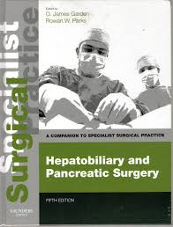
Colorectal Liver Metastases
1. Anatomical Segments of Liver
2. Management Approaches to Colorectal Liver Metastases (CRLMs)
3. Non-surgical Options
Dr David Ryan - 2014
Notes:
Most information is from specialist surgical practice text

Slide 2
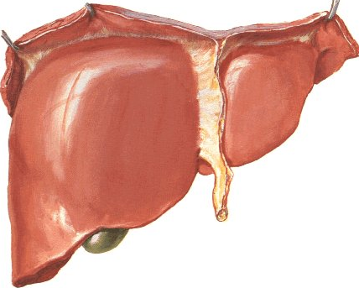
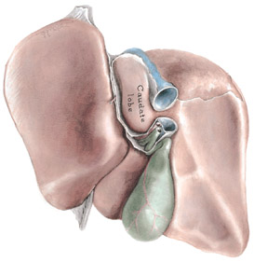
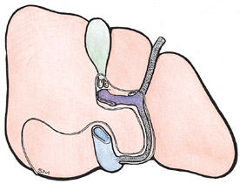
Liver Anatomy
Development within ventral mesogastrium results in peritoneal reflections, attachments & ligaments
Fissures
Lesser Omentum
Anatomical Lobes delineated by ligaments and vertical fissures
Functional Lobes delineated by IVC, GB & Middle hepatic vein
Notes:
The liver develops within ventral mesogastrium, which attaches to the diaphragm, anterior abdominal wall and stomach. As the liver expands and rotates into right upper abdomen, the resulting peritoneal reflections/folds create the coronary and triangular ligaments. The posterior surface, to the right of the IVC, forms a bare area without peritoneum intervening between the liver and posterior abdominal wall. Bare area is delineated by upper and lower coronary ligaments, is in contact with diaphragm, right adrenal gland, is a site of porto-systemic circulation anastomosis (phrenic vessels and azygous veins) and lymphatic communication.
Fissures: Ligamentum teres in free lower margin of falciform ligament creates deep vertical fissure anteriorly (Umbilical fissure), whilst ligamentum venosum creates posterior fissue.
Lesser Omentum connects liver to stomach. Free edge forms hepatoduodenal ligament, containing CBD, Hepatic artery, Portal vein (DAVID). These lie anterior to foramen of Winslow, IVC and right crus of diaphragm.
Left/Right Anatomical Lobes delineated by the falciform ligament/ligamentum teres and ligamentum venosum (+ named caudate + quadrate lobes)
Functional lobes: delineated by IVC and body of GB / Middle hepatic vein. (Quadrate lobe is in functional left lobe, whilst caudate lobe is in both left and right)

Slide 3
Epiploic Foramen (of Winslow)
Communication into lesser sac
Superiorly: caudate lobe
Anteriorly: free edge of lesser omentum contains:
Common bile duct
Hepatic artery
Portal vein
Inferiorly: D1
Posteriorly: IVC + R Crus of diaphragm
Ant -> Post: DAVID
Pringle’s Manoeuvre
Notes:
Caudate lobes lies within lesser sac

Slide 4
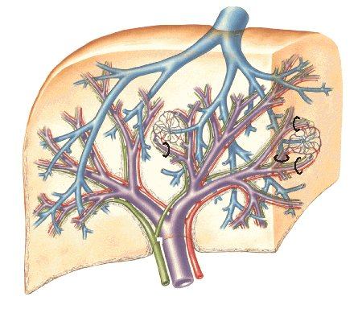
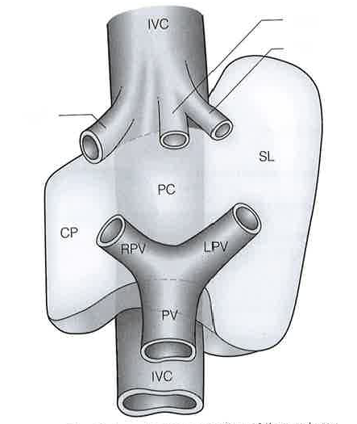
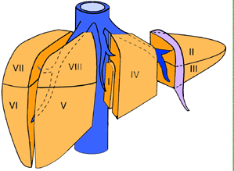
Liver Vessels
Portal vein + hepatic artery (70/30)
Divide into lobules to communicate with hepatic veins
4 Sections
Bordered by hepatic veins
Supplied by sectional hepatic arteries
Drain sectional bile sucts
8 Segments
Couinaud classification
Defined by segmental arteries
Caudate lobe
Quadrate lobe
Notes:
Sectors defined by hepatic veins include right lateral and medial, and left lateral and medial sectors (Lasts text)
Sections defined by the hepatic arteries include right anterior (5/8) and posterior sections (6/7), and left lateral (2/3) and medial sections (4)
Caudate lobe is autonomous receiving blood from both right and left branches of hepatic artery and portal vein, draining bile into right and left hepatic ducts and independent venous drainage to IVC. Caudate process. Areas between segments are termed ‘watershed’ area or intersectional plane.
Quadrate lobe further subdivided into a (superior) and b (inferior) without an exact anatomical plane of separation based on internal ramification of vessels.

Slide 5
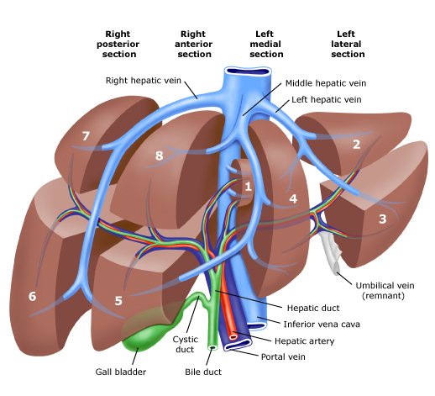
Notes:
Segmental bile ducts unite to form sectional bile ducts. The right posterior sectional bile duct and the Segmental ducts from Sg5 and Sg8 unite to form the anterior sectional bile duct. The sectional ducts unite to form the right hepatic ducts, which unites with the left hepatic duct to form the CHD.
Important anatomical anomalies
20% individuals have anomaly where right posterior sectional duct inserts into the left bile duct. In 6%, right anterior sectional duct inserts into left bile duct. In these people there is no right hepatic duct, and when performing a left hepatectomy the left hepatic duct should be divided close to the vertical/umbilical fissure to avoid injury to a right sectional bile duct.
A right bile duct unites with the CHD below the prevailing site of confluence in 2% individuals. A right subsegmental, segmental or sectional (usually anterior) bile duct that is extrahepatic or uniting with the cystic duct may be at risk in cholecystectomy
Right portal vein divisions follow artery and bile duct divisions. On the left, the portal vein consists of a horizontal or transverse portion (under Sg4) and vertical or umbilical portion in the umbilical fissure.

Slide 6
Variations in Hepatobiliary Anatomy
Notes:
Anatomical variations of right bile duct anatomy can become problematic in left hepatectomy if the left hepatic duct is divided too centrally (see B)

Slide 7
Variations in Hepatobiliary Anatomy

Slide 9
Variations in Hepatobiliary Anatomy
Notes:
Vascular variations: Accessory hepatic arteries can provide some protection from hepatic ischaemia, or can be hazardous at operation if not recognised.

Slide 10
Liver Resection Terminology
Notes:
Segmentectomy = single segment
Bisegmentectomy = 2 segments in continuity
Right anterior sectionectomy = Sg5/8 (bisegmentectomy 5,8)
Right posterior sectionectomy = Sg6/7
Left lateral sectionectomy = Sg2/3
Left medial sectionectomy = Sg4

Slide 11
Liver Resection Terminology
Hepatectomy
Extended Hepatectomy
Notes:
Left hepatectomy/hemihepatectomy = Sg2-4 (+/-Sg1). Extended left hepatectomy includes Sg5/8 (or left trisectionectomy)
Right hepatectomy/hemihepatectomy = Sg5-8 (+/-Sg1). Extended right hepatectomy includes Sg4 (or right trisectionectomy)

Slide 12
Colorectal Liver Metastases (CRLMs)
Most common site of colorectal metastases
25% at initial diagnosis of CRC
50% develop CRLMs < 3 yrs after primary colon resection
Median survival without treatment is 6-8 months
Notes:
Haematogenous spread via portal system to liver sinusoids most common site of colorectal metastases

Slide 13
5 Year Survival for CRLMs
Treatment | 5 year survival (%)
None | 3
Liver resection | 40-50
Multimodal treatment | 40
Notes:
Patients who undergo liver resection have survival rates that plateau at 5 years, after which these patients have a similar survival to matched non cancer patients. 10 year survival of 24%
Multimodal treatment includes resection, interventional radiology, chemotherapy.

Slide 14
Management Approach to CRLMs
Staging
Multidisciplinary Team
Consideration of patient comorbidities and appropriate investigation & treatment options
The aim of pre-operative assessment and post operative follow up surveillance is to identify metastatic disease as early as possible, in order to select patients who might benefit from surgery, adjuvant or palliative chemotherapy, and to exclude those for whom treatment is inappropriate.
Notes:
Staging: extent of hepatic disease, extrahepatic disease, peritoneal disease, regional or distant lymph node disease, pulmonary mets, bone/brain mets.
Staging workup includes: bloods: liver enzymes, tumour markers. Recent colonoscopy (<12mths). Imaging, including CT CAP, PET CT.
(Liver function: Indocinin Green, Portal Wedge Pressure)

Slide 15
Investigations: CT
Triple phase CT
Assess lesion enhancement patterns
In arterial phase: rim enhancement
In portal venous phase: liver mets are relatively hypodense compared to normal liver parenchyma
Better imaging for detecting extrahepatic disease
90% sensitivity for >1cm lesions
Notes:
Triple phase: NC, arterial, portal venous.
Arterial phase: hyperdense surrounding ring
Liver mets are arterial supply dominant, hence enhance more on arterial phase with a hyperdense outer ring, whilst in portal venous phase are relatively hypodense (avascular) compared to normal liver parenchyma.
US may demonstrate hyperechoic lesions (compare with benign lesions) 90% specificity if lesions >2cm, only 56% specificity if smaller.

Slide 16
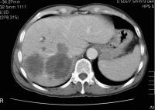
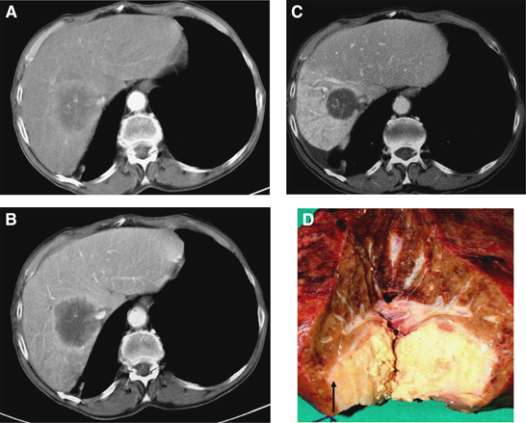
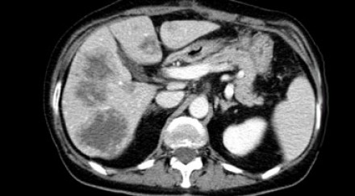
CT imaging of CRLMs
Notes:
A/ Top row: contrast enhanced images: rim enhancement
B/ Bottom row: portal venous phase images: hypovascularity/hypodense

Slide 17
Investigations: MRI
Features of CRLMs:
Low signal intensity on T1
Moderately high signal intensity T2
Central necrosis enhancement
Primovist: Rim enhancement
Delayed phase Primovist: lesion has no contrast take up.
Low sensitivity for detecting extrahepatic disease
Notes:
Contrast agents: Gadolinium behaves similar to iodinated contrast agent for CT
Primovist/SPIO/DPDP/Teslascan are not taken up by CRLM
Delayed phase primovist identified by contrast in biliary tree

Slide 18
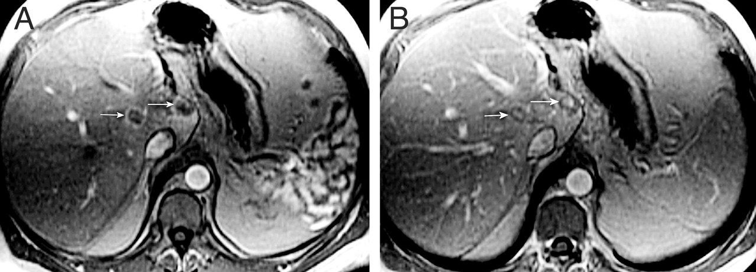
MRI Imaging of CRLMs
Notes:
A: gadolinium contrast enhanced imaging. arrows indicate lesion with rim enhancement
B: delay phase peripheral washout

Slide 19
Investigations: PET
Greater metabolic activity = glucose avid
Mucinous CRC less glucose uptake
FDG-PET
High sensitivity in combination with CT for hepatic and extrahepatic disease. Low sensitivity for lesions <1cm

Slide 20
Operative Investigations
Staging Laparoscopy
Intraoperative ultrasound
Scintigraphy: Calculate hepatic perfusion index (HPI) and doppler perfusion index (DPI)
Notes:
HPI is altered in liver mets due to increased arterial flow and decreased portal venous flow.

Slide 21
Prognostic Factors
Negative
Positive
Extensive disease at Dx
High grade tumour
Abnormal LFTs
Extrahepatic spread
Unresected primary
Multiple or bilateral tumours
Single lobe involvement
Limited number of mets
Metastatic disease >1yr post primary
Notes:
Tumour burden is the major determinant of outcome

Slide 22
Memorial Sloan Kettering Cancer Centre Study
Clinical Risk Score 0-5
1. Node positive primary tumour
2. Prehepatectomy CEA >200
3. >1 liver tumours
4. Liver tumour size >5cm
5. Disease free interval <1yr
Score | % Irresectable | Irresectable lesions found at laparoscopy
0-1 | 4% | 0%
2-3 | 21% | 11%
4-5 | ? | 24%
Notes:
Node positive primary may reflect higher grade tumour, and represents a more advanced stage primary, which is a consistent predictor of long term outcome.
CEA >200 is an independent predictor of poor survival
Number and distribution of mets significant. Greater likelihood of cure if <4mets
>5cm associated with poorer outcome, however overall size probably not significnat influence on survival post hepatectomy
Symchronous v metachronous disease. Poorer outcome in patients having resection of synchronous mets, and better survival in patients with longer disease free intervals. This may reflect tumour biology & grade.

Slide 23
Survival with CRLMs
Treatment | 5 year survival (%)
None | 3
Liver resection | 40-50
Multimodal treatment | 40
Stage | Tumour Size | Nodal Disease | Other mets | 5 year survival
Stage I | mT1 | N0 | M0 | 61%
Stage II | mT2 | N0 | M0
Stage III | mT3 | N0 | M0 | 28%
Stage IVa | mT4 | N0 | M0 | 20%
Stage IVb | Any mT | N1 N0, N1 | M0, M1 M1 | 0%
mT1 – solitary <2cm
mT2 – solitary >2cm unilobar or multiple <2cm unilobar
mT3 – multiple >2cm unilobar
mT4 – solitary or multiple bilobar, invasion of major vessel branch or bile duct
N1 – abdominal lymph node disease
M1 – extrahepatic metastases or direct invasion to adjacent organs

Slide 24
Criteria for Liver Resection (old)
Patients with up to 4 lesions that can be safely removed with an adequate margin and have no evidence of extrahepatic disease should be considered for resection
<4 lobes involved
Presenting >1yr after resection of primary
At least 1cm margin of liver tissue
No hilar or extrahepatic disease
2006 Consensus Statement from American Hepato-Pancreato-Biliary Association:
Patients with CRLMs should be considered for resection if:
Disease can be completely resected
Two adjacent liver segments can be spared with adequate vascular inflow, outflow and biliary drainage
Volume of remnant liver is adequate
Notes:
1. Complete resection regardless of margin
3. Suggested minimum residual liver volumes:
20% normal liver (2 of 8 segments)
30% post neoadjuvant chemotherapy
40% cirrhotic liver

Slide 25
Contraindications for resection
General criteria
Liver Lesions
Non treatable primary tumour
Widespread pulmonary disease
Locoregional recurrence
Uncontrollable peritoneal disease
Extensive nodal disease
Bone or CNS metastases
Invasion of one branch of liver pedicle and contact with contralateral branch
Invasion of portal vein confluence
Contact with IVC
Invasion of all 3 hepatic veins
Insufficient residual liver
Coeliac lymphadenopathy
Non-resectable extrahepatic disease
Notes:
There are no absolute contraindications to surgical resetion of CRLMs as long as the disease can be fully resected (including extrahepatic disease). The use of advanced surgical techniques may bring patients previously irresectable to surgery with curative intent.
Retroperitoneal or mediastinal lymphadenopathy
Suggested minimum residual liver volumes:
20% normal liver
30% post neoadjuvant chemotherapy
40% cirrhotic liver

Slide 26
Strategies to Improve Resectability
Portal Vein Embolisation
Induces atrophy of liver to be resected and hypertrophy of liver that will remain
2 Stage Hepatectomy
For bilateral lesions
Minor resection first to allow regeneration & hypertrophy prior to major resection.
1YS 70%, 3YS 55%
‘Induction’ or ‘Conversion’ chemotherapy
Notes:
PVE: Induces atrophy of liver to be resected and hypertrophy of liver that will remain (within 2-4 weeks). Reduce volume of parenchyme resected, therefore reduces risk of postoperative hepatic insufficiency, failure and death.
A delay between hepatectomies allows remnant to hypertrophy for 2nd resection to proceed without leading to liver failure. Minor disease segment resected first +/- PVE or ligation to major disease side + systemic chemotx. After 2-3 months to allow regeneration & hypertrophy of minor side, major resection is performed. 1YS 70%, 3YS 55%

Slide 27
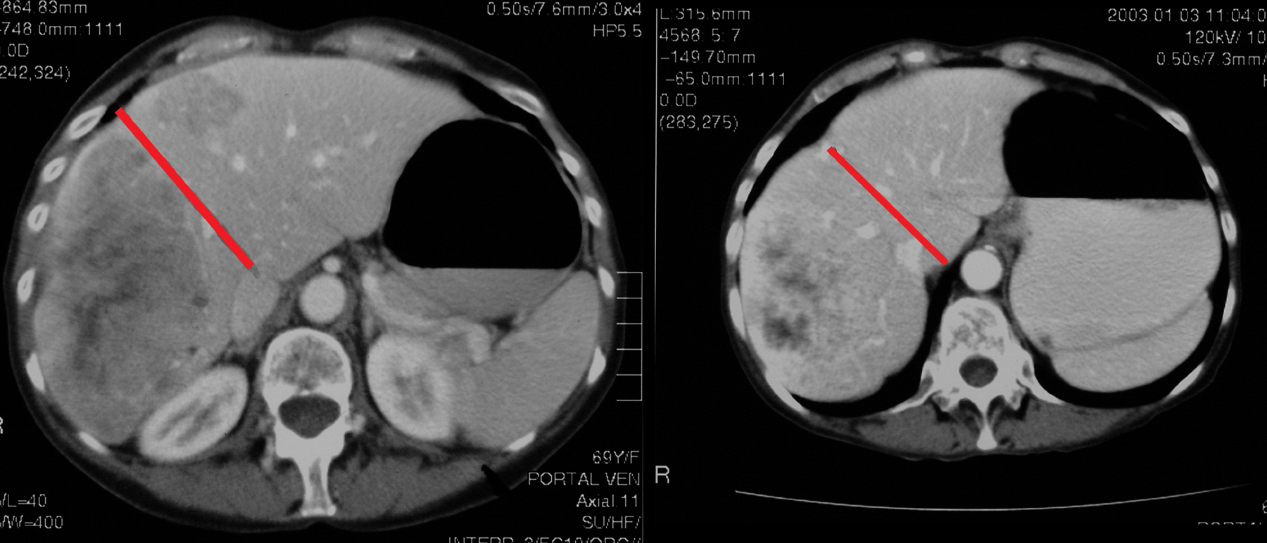
Conversion Chemotherapy
Notes:
Liver, metastases. Contrast-enhanced transaxial CT images in the portal venous phase through the liver of a 48-year-old man with colonic metastases. The left image shows metastases in both lobes of the liver and, thus, inoperable. The right image was taken 2 months after oxaliplatin therapy. The metastases were downstaged. The patient underwent a successful right hepatectomy.

Slide 28
Surgery
Hepatic segmentectomy is preferable to non-segmental resection for small localized lesions unless this increases the risk of postop liver failure.
For small or awkwardly positioned lesions (eg apex of segment VIII) local resection may be preferable.
Extensive disease requiring radical resections (more than one lobe) have a poorer outcome.

Slide 29
Techniques for Minimising Blood Loss
Inflow occlusion (Pringle’s manoeuvre)
Low CVP
CUSA (ultrasonic aspirating dissector)
Hydrojet (pressured water jet)
TissueLink (dissecting sealer using radiofrequency energy)
Notes:
Reduced intraoperative liver perfusion may cause ischaemia and reperfusion injury

Slide 30
Laparoscopic Liver Resection
Current data based on retrospective series
Equivalent oncological outcomes, with reduced operative blood loss and LOS.
Safe and effective in appropriately trained surgeons.

Slide 31
Morbidity and Mortality after Liver Resection for CRLMs
30 Day Mortality 0-6.6%
Hepatic failure
Postoperative haemorrhage
Generalised sepsis
Cardiac failure
Multi-organ failure
Pulmonary embolism
Bile leak
Anastomotic leak
Mobidity
Wound infection (5.4%)
Generalised sepsis (4.6%)
Pleural effusion (4.3%)
Bile leak (4%)
Perihepatic abscess (3.0%)
Hepatic failure (2.8%)
Arrhythmia (2.8%)
Post operative haemorrhage (2.7%)
Cardiac failure (2.4%)
Pneumonia (1.9%)

Slide 32
Chemotherapy for CRLMs
Treatment goal:
Prolong life
Conversion of irresectable to resectable tumour
Reduce occult disease burden
Chemotherapeutic agents
5FU
Oxaliplatin
Irinotecan
Cetuximab (mAb) inhibits EGFR
Bevacizumab (mAb) inhibits VEGF receptors
Combination Regimens: FOLFOX, FOLFIRI
Notes:
EGFR: extracellular growth factor receptor. Patients with KRAS proto-oncogene mutation are resistant to treatment.
VEGF: vascular endothelial growth factor
Good performers on chemotherapy may by better candidates for surgical resection.
Adjuvant chemotherapy has not been shown to improve survival following resection

Slide 33
Complications of Chemotherapy
Irinotecan
Sinusoidal dilation
Oxaliplatin
Steatohepatitis
Bevacizumab
Impaired healing/regeneration
Regional Chemotherapy
Catheter
Biliary stricture
Peptic ulceration

Slide 34
Hepatic Arterial Infusion (HAI)
Targeted dosing of chemotherapy with reduced systemic dose
Catheter inserted into proximal GDA or hepatic artery at laparotomy
Cholecystectomy
Response rate 41% compared with systemic chemotherapy 14%, but no improved survival
Notes:
Cholecystectomy to prevent cholecystitis
Ligation of branches of hepatic artery to stomach, CBD, pancreas

Slide 35
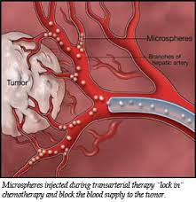
TACE
Drug eluting beads are compressible microspheres produced from polyvinyl alcohol (PVA) hydrogel loaded with drug (Irinotecan)
DEB-TACE uses combination embolisation and chemotherapy
Notes:
Trans-arterial Chemoembolisation

Slide 36
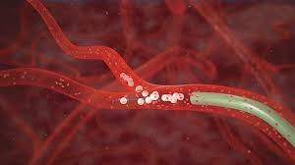
SIRT
Selective Internal Radiation Treatment
Intra-hepatic arterial administration of yttrium-90 microspheres, emitting high energy beta particles
Delivered via arterial embolisation

Slide 37
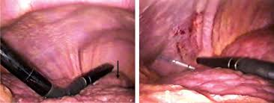
Ablation Therapies
Radiofrequency ablation (RFA)
Microwave ablation (MWA)
Cryotherapy
Laser hyperthermia
Ethanol injection
Notes:
Ablation therapies may be used as adjunct to resection, or replace resection in patients who cannot undergo resection due to comorbidities or insufficient liver volume.
RFA uses direct current transmission through tissue to generate heat and cause ablation. Diminished effectiveness with increased tumour size.
MWA uses electromagnetic waves that agitate water molecules in tissue, producing friction, heat and cell death.
Cryotherapy uses probe with liquid nitrogen directly applied to tumour at laparotomy
Ablations can be performed percutaneously, laparoscopically or at laparotomy
Post ablation symdromes: fevers, abdominal pain, transaminitis.

Slide 38
Radiofrequency Ablation

Slide 39
Summary Statements
The aim of pre-operative assessment and post operative follow up surveillance is to identify metastatic disease as early as possible, in order to select patients who might benefit from surgery, adjuvant or palliative chemotherapy, and to exclude those for whom treatment is inappropriate.
There are no absolute contraindications to surgical resection of CRLMs as long as the disease can be fully resected (including extrahepatic disease). The use of advanced surgical techniques and chemotherapy may bring patients previously irresectable to surgery with curative intent.

Slide 40
Staging Systems
Stage | Criteria | Survival
IVa | Easily resectable with curative intent at detection
IVb | Technically difficult / borderline resectable at detection
IVc | Potentially resectable after neoadjuvant chemotherapy
IVd | Little or no hope of being rendered resectable with curative intent after chemotx
Va | Resectable extrahepatic disease
Vb | Unresectable extrahepatic disease

