Slide 1
Portal hypertension & chronic liver disease
Sean CHEN
St George Hepatobiliary & Pancreatic workshop
31/05/2014

Slide 2
Chronic Liver Disease
Chronic Liver disease
Progressive destruction and regeneration process of the liver
Associated with cell death, bridging fibrosis and long term cirrhosis
Classification of chronic liver disease
Child-Pugh Score
Originally derived to predict surgical mortality, now used to assess prognosis of chronic liver disease
3 classes of severity with associated 1 and 2 year survival rates

Slide 3
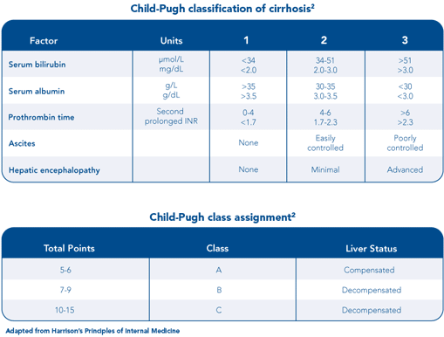

Slide 4
Causes of chronic liver disease
Viral
Hepatitis B
Hepatitis C
Cytomegalovirus
Epstein Barr Virus
Autoimmune
Autoimmune chronic hepatitis
Primary biliary cirrhosis
Primary sclerosing cholangitis
Toxin
Alcoholic liver disease
Methotrexate
Amiodarone
Nitrofurantoin
Metabolic
Non-Alcoholic fatty liver disese
Haemochromatosis
Wilson’s Disease

Slide 5
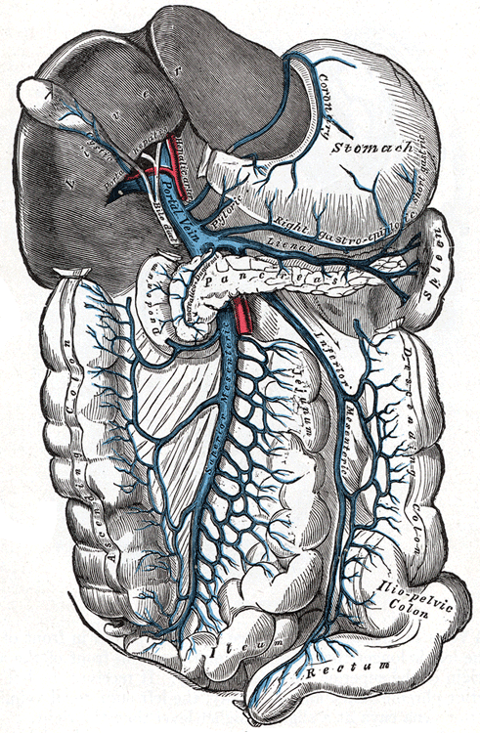
Portal Vein
Upward continuation of the superior mesenteric and splenic vein
Tributaries
Superior mesenteric vein
Splenic vein
Right and left gastric vein
Superior pancreaticoduodenal vein
Cystic vein
Periumbilical vein
Contribute 75% of blood supply to the liver
Brings nutrient and toxin rich blood to the liver
Normal intraluminal pressure of 5 to 10 mmHg

Slide 6
Portal hypertension
Pathological increase in pressure in portal venous system as compared to the rest of the body. Where the pressure gradient between the portal vein and IVC (Liver portal perfusion pressure) is > 5mmHg
Pathophysiology – Ohms Law
P = QR (pressure = resistance x inflow)
Changes in increasing portal resistance or blood inflow leads to increased portal pressure and vice versa

Slide 7
Causes of Portal Hypertension
Pre-hepatic
Portal vein thrombosis
Congenital atresia
Post hepatic
Hepatic vein thrombosis or IVC thrombosis
Constrictive pericarditis
Intrahepatic
Cirrhosis
Fibrotic disease
Wilson’s disease
Haemochromatosis
Schistosomiasis
Massive fatty changes
Diffuse granulomatosis disease

Slide 8
Measurement of portal pressures
No way of indirect measurement
Direct measurement involves measuring and comparing the pressure of both the portal and hepatic veins
Gold standard - Hepatic Vein Pressure Gradient (HVPG)
> 5 mmHg portal hypertension, > 10 mmHg clinically significant
Difference between the Wedge Hepatic venous Pressure (WHVP) and Free Hepatic venous Pressure (HVPG)

Slide 9
HVPG
WHVP
Angiographic procedure
Obtained by measuring the pressure in the hepatic vein after a catheter is used to wedge the hepatic vein shut (measurement of static blood pressure)
Measures hepatic sinusoidal pressure
FHVP
Angiographic procedure
Obtained by measuring the pressure in the hepatic vein at 2 – 4cm from opening to IVC

Slide 10
Treatment of oesophageal Varices
Most causes of portal hypertension can’t be treated and most acute treatment deal with management of oesophageal varices
Medication (beta-blocker +/- vasoactive drug depending on presence of varcieal bleeding)
Endoscopic procedure
TIPS
Surgical Portacaval shunt

Slide 11
Treatment of portal hypertension (TIPS)
Transjugular Intrahepatic Portasystemic Shunt (TIPS)
Angiographic procedure to form a tract between hepatic vein and intrahepatic segment of portal vein
Indications
Uncontrolled Variceal Haemorrhage not responding to endoscopic and medical management
Refractory ascites
Hepatic pleural effusion
Contraindications
Severe and progressive liver failure
Severe encephalopathy
Polycystic liver disease
Severe right heart failure

Slide 12
Treatment of portal hypertension (portacaval Shunt)
Surgical procedure to create a shunt from the portal vein to the IVC
Indications
Uncontrolled variceal bleeding non-responsive to medical therapy (associated with high mortality)
Early Budd-Chiari Syndrome
Intractable ascities unresponsive to nonsurgical therapy
Failed TIPS
Contraindications
Thrombosis of portal vein without liver disease
Hepatic artery occlusion

Slide 13
liver transplant
Indications of liver transplant
Life threatening acute or chronic liver disease not amenable to alternative therapy
Extrahepatic manifestations of inborn error of metabolism
Referred by a recognised liver transplant unit
Contraindications
HIV
Active alcohol or substance abuse
Systemic infection
Inability to comply with transplant medication regimen (psuchiatric disorders)
Other life limiting medication co-morbidities

Slide 14
Questions?
Thank you for listening

