Slide 1
Intercostal catheters
Slide 1/14
Liverpool Monday Registrar Teaching
Term 1 2015
Dr Gratian Punch

Slide 2
Scope of this session
Slide 2/14
Timeline
Start 0700hrs
30min education session
End 0730hrs
Introduction
Scope + Timeline review
Guided study
Assumed reading
Good reading list
Anatomy of Chest Wall
Indications for Chest drain
How to put in a chest drain - video
Group Discussion / Pointers for Insertion
Complications of Chest Drains
Know your drainage system or how to make one
When and how to remove a chest drain
Closure and Question's

Slide 3
Guided study - Assumed Reading
Slide 3/14
Handbook of Trauma Care – The Liverpool Hopsitall trauma manual 6th Ed
http://www.sswahs.nsw.gov.au/liverpool/trauma/handbook1.html
Previous Presentations on Chest Drains / Intercostal Catheters (found at www.175days.com.au)
Term 1 2014 - Chest drains Dr Cpilasi http://175days.com.au/monday-registrar-teaching/term-1-2014/
Term 2 2014 - Chest Drains – Insertion and Troubleshooting – Dr M Jarmin http://175days.com.au/monday-registrar-teaching/term-2-2014/
Related Papers:
as emailed / found at http://175days.com.au/monday-registrar-teaching/term-2-2014/
Chest Drain Visceral Injuries
Kong, Clarke Injury, Int.J.Care Injured 45(2014)1435–1439
Pleural decompression in trauma reception and resuscitation
Fitzgerald, Injury, Int. J. Care Injured (2008) 39, 9—20

Slide 4
Guided study – Good reading list
Slide 4/14
Chapter 4 - Advanced Trauma Life Support (ATLS) for Doctors Student Course Manual 9th Edition
MyATLS App (Google / Apple)
Chapter 11 - Chest Tube Insertion, Pages 135-142, Surgical Pitfalls: Prevention and Management Elsevier Health Sciences, 2009 Aarti Mathur, Stephen R.T. Evans

Slide 5
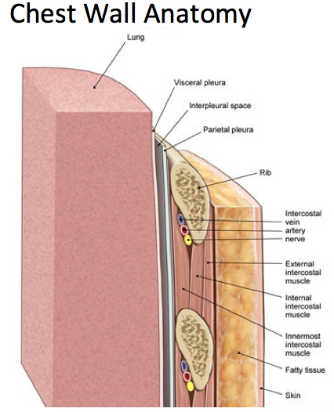
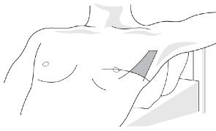
Anatomy of the chest wall
Slide 5/14
Need to Know
Layers
NV bundle location (VAN)
Surface markings for rib levels
Approx. Nipple Level (be careful)
Infra-mammary fold
Points of pleural reflection (Last’s 9th ed)
Level of diaphragm at insp/expiration
Triangle of Safety

Slide 6
Indications for chest drain
Slide 6/14
Gas / Fluid / Pus
Pneumothorax
Haemothorax
Pleural Effusions
Chylothorax
Empyema
Trauma:
Pneumothorax: accumulation of air or gas in the pleural space.
Haemothorax
Routine Postop : eg. thoracotomy, oesophagectomy, cardiac surgery, posterior renal approach

Slide 7
Know your equipment (QUICK INTERACTIVE)
Slide 7/14
French Catheter Gauge System (Bigger = Bigger)
Size Diameter (mm) = Fr / 3
French Needle – Gauge system (bigger = smaller)
The Chest drains – sizes
Explain the “French sizing system”
Which size do you choose
The equipment required for insertion:
Describe the “basics” if no kit available
What is in the kit?
The Dressings
Connecting / Securing the Tubing
The UWSD – discussed later
Suction or No suction (Low / wall / settings)

Slide 8
How to place a chest drain (Atls video)
Slide 8/14
If link not working then visit:
YouTube ATLS Chest drain video
http://youtu.be/qR3VcueqBgc

Slide 9
Slide 9/14
YOU WILL NEED TO EITHER:
WATCH THE VIDEO AS SEPARATE FILE ON THIS SITE
FIND VIDEO ON YOUTUBE
AS FILE WAS UNABLE TO BE UPLOADED WITH THIS VIDEO DUE TO SIZE RESTRAINTS

Slide 10
Group discussion / pointers
Slide 10/14

Slide 11
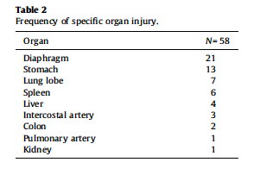
Complications of chest Drain's
Slide 11/14
ANYTHING CAN BE DAMAGED BY INSERTIPON OF A CHEST DRAIN
THORACIC CAVITY
RETROPERITONEAL
ABDOMINAL CAVITY
YOURSELF / ASSISTANTS
International publication rates of
complication 10-30% and mortality at least 4%
V.Y. Kong, D.L. 1436 Clarke
Injury, Int. J. Care Injured 45 (2014) 1435–1439

Slide 12
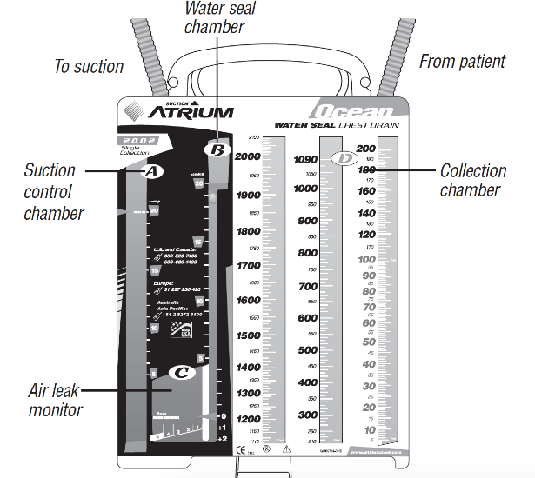
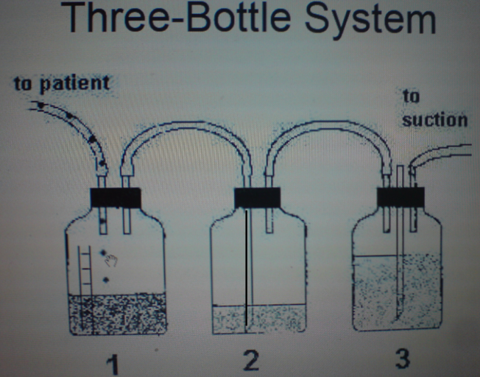
Know your drainage system (or how to make one)
Slide 12/14
Favoured question on FRACS Part II Pathophysiology – draw the setup of a 3 chambered UWSD ???

Slide 13
How to remove a chest drain
Slide 13/14
A chest drain should be removed only when:
all air leak and fluid drainage has ceased
Lung should be fully expanded on chest X-ray
A chest tube must never be ‘clamped’ prior to removal
How?
The patient is asked to breathe out maximally then the tube is briskly removed and an occlusive dressing placed over the wound.

Slide 14
Closure and questions
Slide 14/14

