Slide 1
investigations of the breast lump
Azra Tabassum

Slide 2
Facts about Breast cancer
Worldwide increasing incidence -> 1 million newly diagnosed cases each yr
2nd leading cause of death and 2nd most common cancer in women
Mortality highest in UK ---28th deaths/100,000women per anum
Incidence increasing with age
All women are at risk
Most masses are benign; that is, they are not cancerous, do not grow uncontrollably or spread, and are not life-threatening.
• Some breast cancers are called in situ because they are confined within the ducts (ductal carcinoma in situ or DCIS) or lobules (lobular carcinoma in situ or LCIS) where they originated.
The majority of in situ breast cancers are DCIS, which accounted for about 83% of in situ cases diagnosed during 2004-2008.

Slide 3
Australian facts & figures
Breast cancer is a major cause of illness and death for females in Australia
On average, one in eight Australian females will develop breast cancer and one in 37 females will die from it before the age of 85 years.
In 2008 in Australia:
• Breast cancer was by far the most commonly diagnosed invasive cancer in females , accounting for 28% of all cancers in females
• A total of 13,567 breast cancers were diagnosed in Australian females.
More than 69% of breast cancers were diagnosed in those aged 40–69
The risk that a female would be diagnosed with breast cancer before the age of 85 was 1 in 8.

Slide 5
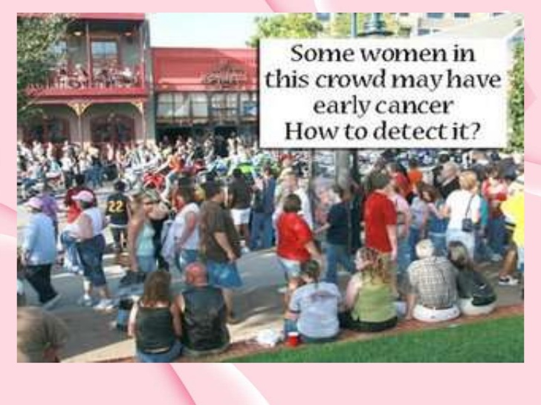
How to detect breast lump and further investigate

Slide 6
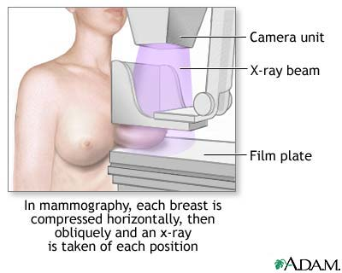
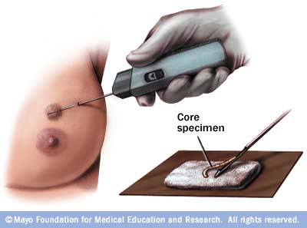
Triple assessment
Diagnostic tests – all breast lumps or suspected carcinoma
History and clinical examination
Radiological assessments
Cytological assessment
Staging investigation
Liver US
Staging CT
Chest x ray
Bone scan
Sensitivity of triple assessment with regard to histopathology is 100, Specificity is 99.3% and concordance is 99.3%.

Slide 7
Relevant History in Women with Palpable Breast Masses
Breast lump characteristics
Changes in size over time
Change relative to menstrual cycle
Duration of mass
Pain or swelling
Redness, fever, or discharge
Diet and medications
Current medications

Slide 8
Risk Factors for Breast Cancer
Well-established risk factors | Probable risk factors
Age 50 or older Benign breast disease, especially cystic disease, proliferative types of hyperplasia, and atypical hyperplasia Exposure to ionizing radiation First childbirth after age 20 Higher socioeconomic status History of breast cancer History of breast cancer in a first-degree relative Hormone therapy Nulliparity Obesity (i.e., BMI ≥ 30 kg per m²)* | Alcohol consumption Did not breastfeed Elevated endogenous estrogen levels High BMI*Hormonal contraception therapy Increased mammographic density of breast tissue Menarche before age 12 Menopause after age 45 Mutations in BRCA 1 and BRCA 2 genes

Slide 10
Palpable lesions are always imaged before a biopsy is done.

Slide 11
Breast imaging studies
Ultrasound
Film screen mammography
( Screening and diagnostic)
Digital Mammography
Nuclear medicine
MRI
CT
Galactography

Slide 12
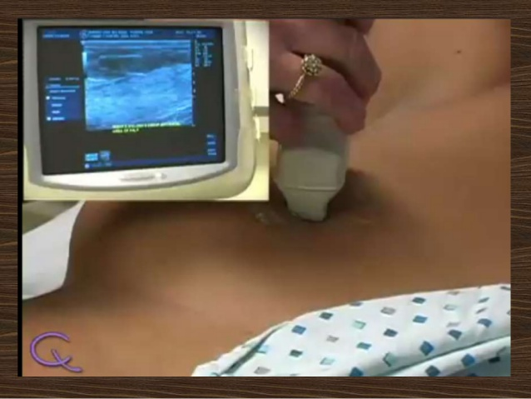
Ultrasound
Ultrasound has become a
valuable tool in assessing
breast masses, as it is
widely available, quick to
perform, non-invasive and
less expensive than other
imaging modalities.

Slide 13
The specificity of ultrasound in
detecting cystic lesions is 98%, and cysts ≥2 mm can be detected.

Slide 14
Ultrasound fcats
Ultrasound has a higher sensitivity than mammography in detecting lesions in women
with dense breast tissue
In this setting, its use as an adjunct to mammography may increase the accuracy by up to 7.4%
With regard to clinically palpable solid lesions, the specificity of ultrasound is superior
to mammography: 97% versus 87%
Complementary modality to an equivocal CBE and a normal mammogram in determining whether a mass is present
The evaluation of non palpable lesions detected on screening mammography,
image-guided biopsy of lesions and follow-up of benign lesions such as fibroadenomas.
It is an operator dependent technique with a lower sensitivity than mammography.

Slide 16
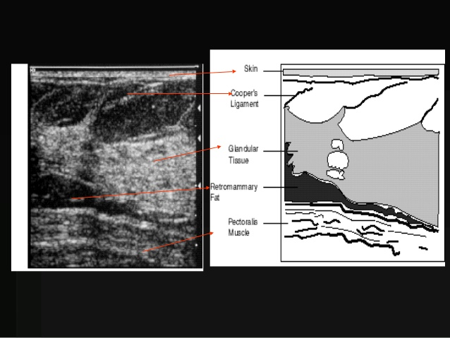

Slide 18
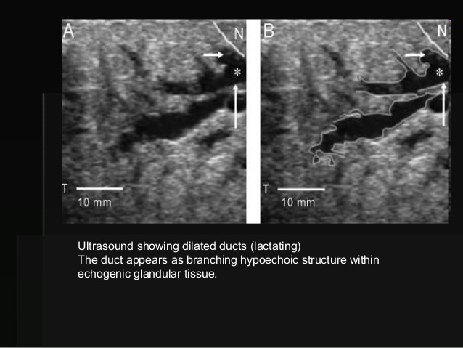

Slide 24
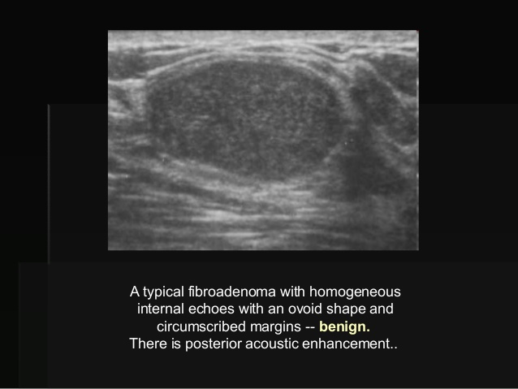

Slide 28
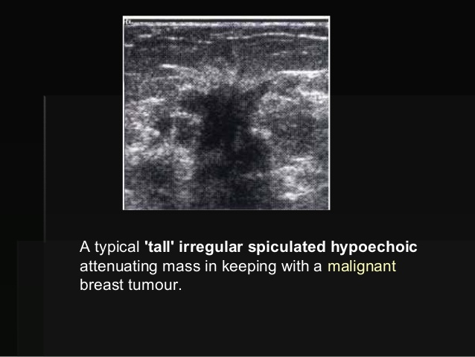

Slide 29
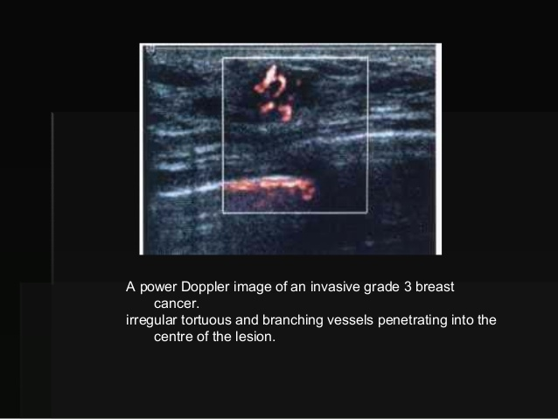

Slide 31
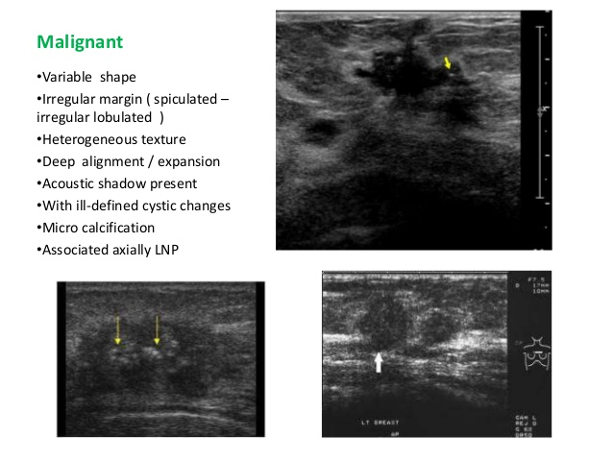

Slide 32
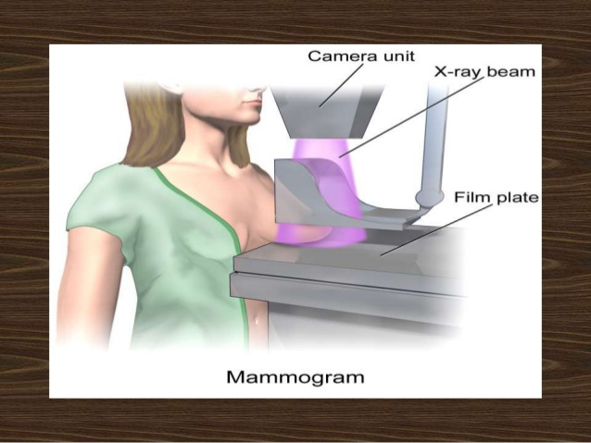
Mammogram

Slide 33
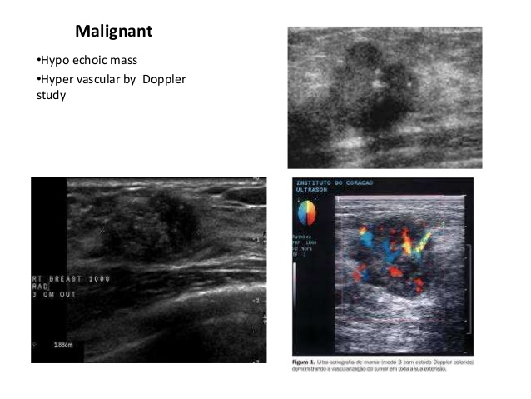

Slide 34
Facts
The sensitivity of diagnostic mammography is around 90% (90% in fatty replaced breast and 65% in dense breast ) and and the specificity up to 88%.
Bilateral synchronous cancers are reported in 3% of cases; approximately 65% of these are detected only by mammography.
The known false negative rate of mammography is between 8% and 10%.
The sensitivity of mammography is decreased by dense breast tissue obscuring a
lesion.
False-negative results arise with poor technique and inadequate views that do not
include the mass, or when the findings are misinterpreted by the radiologist, notably
when there is overlap in the mammographic features of benign and malignant masses

Slide 35
Mammography

Slide 37
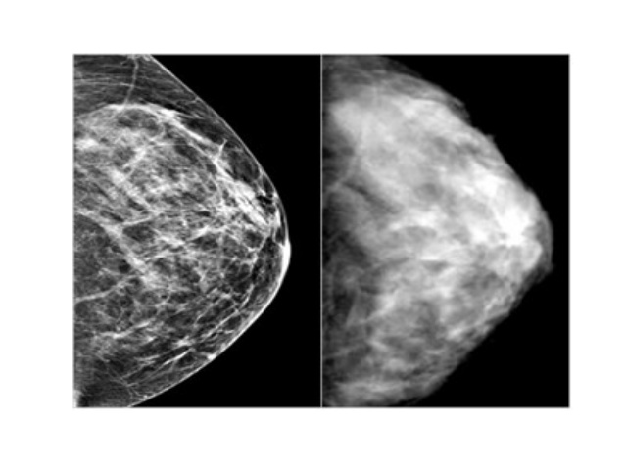
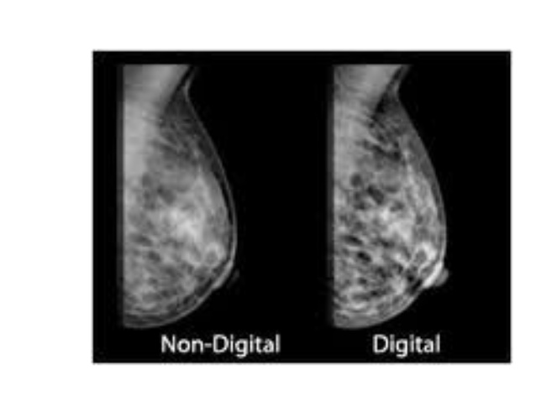
Digital vs film screen mammography
Advantages of digital mammography include better image quality, fewer artefacts, fewer patient recalls and telemammography.

Slide 39
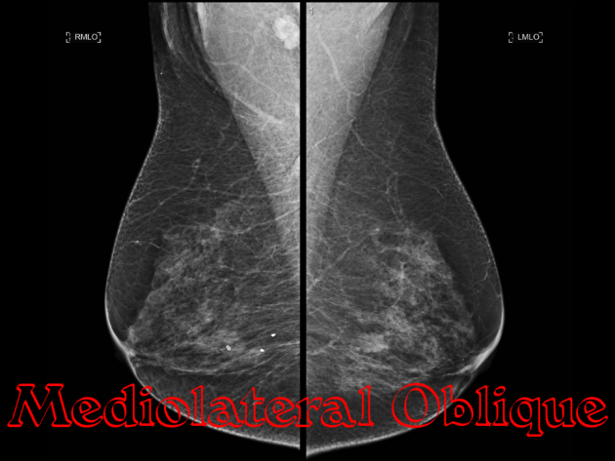
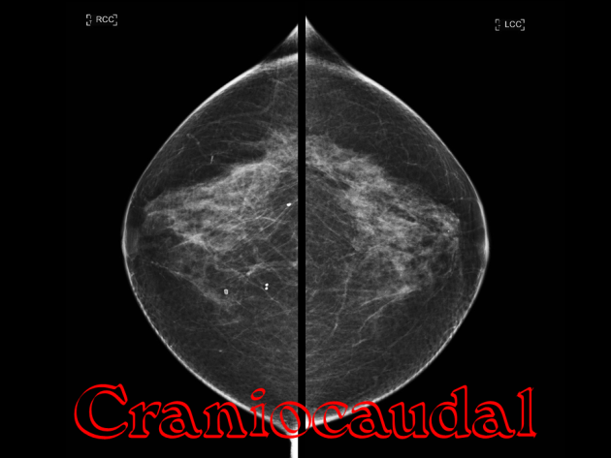
Mammographic view
Standard views
Mediolateral View – MLO views Craniocaudal views CC Views

Slide 41
Craniocaudal Views
abnormality demonstrated are seen medical or lateral to the nipple
for lateral pathologies is more clearly demonstrated by rotating the breast medically
and
for medical pathology rotating
the breast laterally

Slide 42
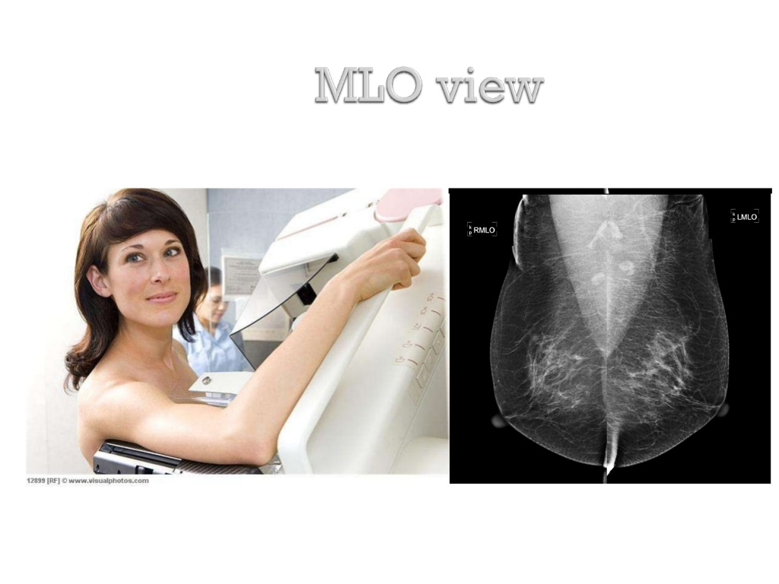
Mediolateral Views
Demonstrate the maximum amount of the breast tissue.
A technically adequate exam has the nipple in profile, allows visualization of the
Axillary tail
pectoral muscle
inframammary fold

Slide 43
Mammographic view
Additional views – additional information
Extended CC view -- medical or lateal rotation
Extended CC VIEWS – Cleopatra views
True lateral
Axillary view – Axillary tail view
Cleavage views– valley views
Paddle compression views
Spot views
Magnification views
Eklund views – for breast implant

Slide 44
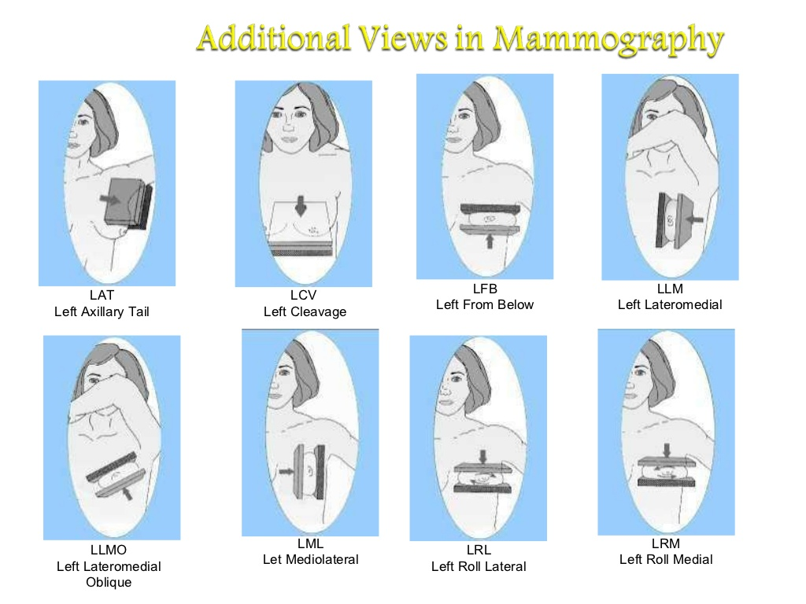

Slide 45
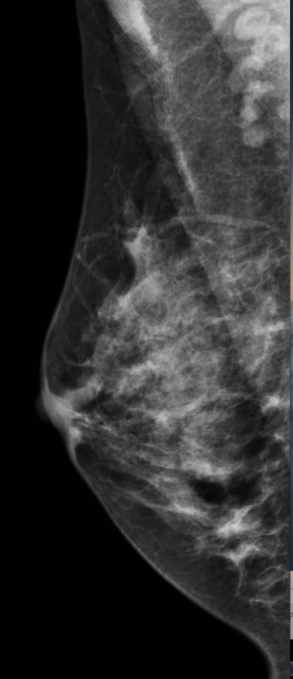
An axillary view (also known as a "Cleopatra view“) is a type of supplementary mammographic view.
It is an exaggerated craniocaudal view for better imaging of the lateral portion of the breast to the axillary tail.
This projection is performed whenever we want to show a lesion seen only in the axillary tail on the MLO view. An optimal axillary view require to be clearly displayed the most lateral portion of the breast including the Axillary tail, as well the pectoral muscle and the nipple in profile.

Slide 46
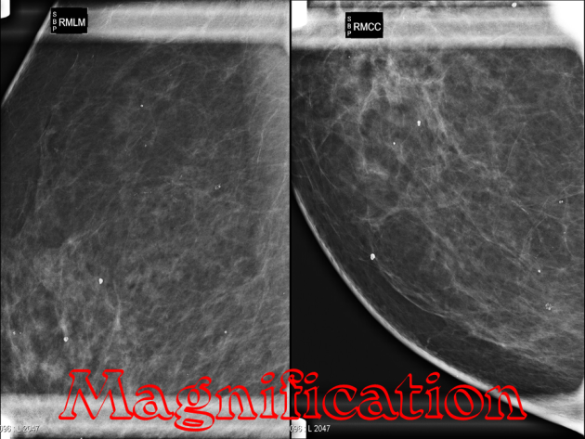
A magnification view is performed to evaluate and count microcalcifications and its extension (as well the assessment of the borders and the tissue structures of a suspicious area or a mass) by using a magnification device which brings the breast away from the film plate and closer to the x-ray source.

Slide 47
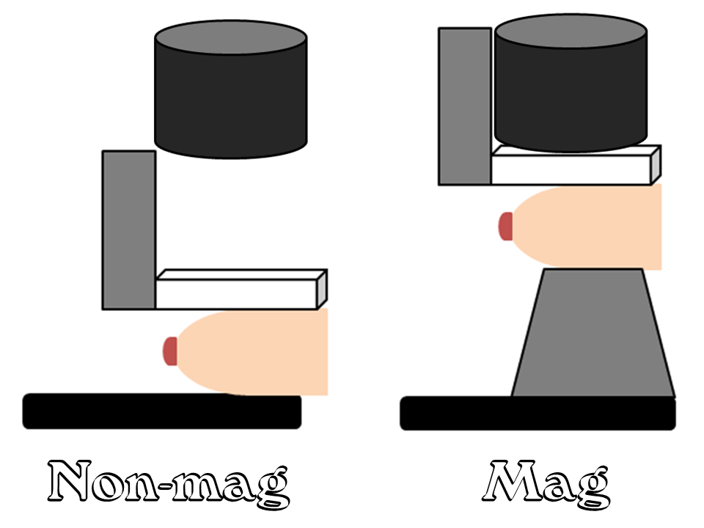

Slide 48
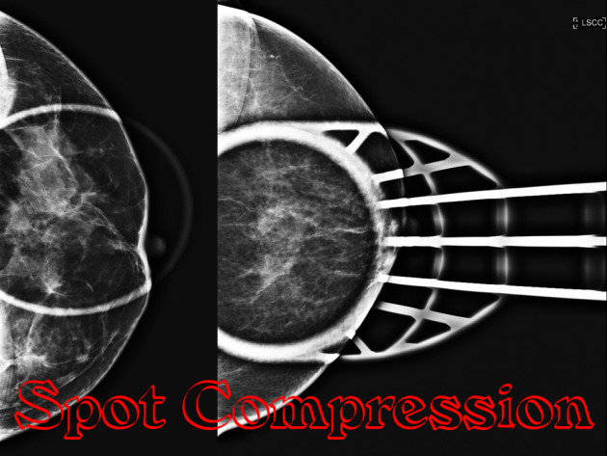
Spot magnification views
are a combination of spot compression (small paddle) and magnification (mag stand and settings) techniques. Spot magnification is often used to evaluate the margins of a mass.
Any time you are doing a spot or spot mag view, it is critical that your image includes the lesion in question.

Slide 49
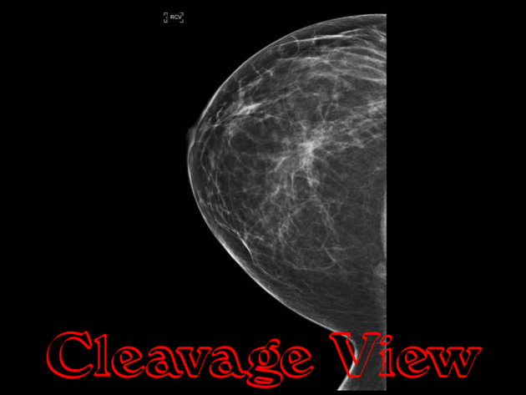
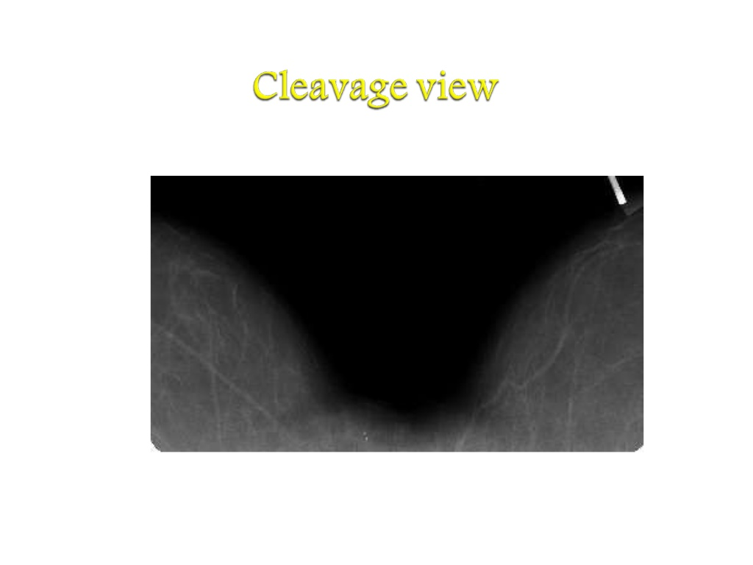
The cleavage view is another attempt at maximizing visualization of medial breast tissue when some of the breast being imaged may get pulled or left out of the compression field, or when a finding in the mediolateral-oblique view cannot be found on the cranial-caudal view.

Slide 50
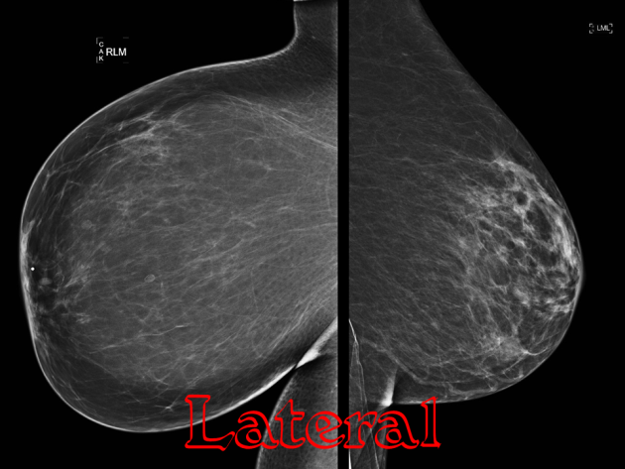
The lateral view is an additional view obtained at virtually every diagnostic evaluation. A lateral view may be obtained as a mediolateral (ML) or lateralmedial (LM) view depending on where the imaging tube and detector are located.
The ML view is best for lesions located in the central or lateral breast.
LM views are extremely useful in determining the exact location of an abnormality in the breast.

Slide 51
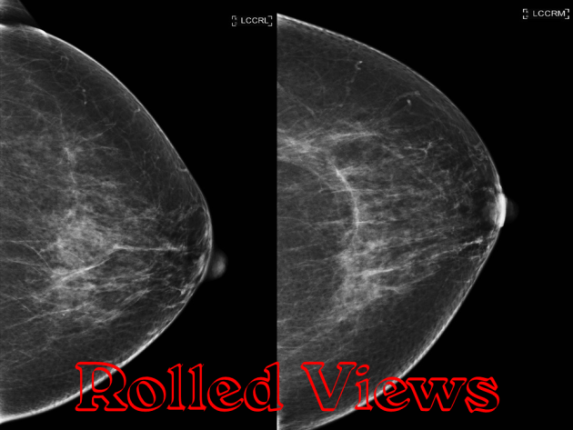
Rolled views (rolled medial and rolled lateral) are used in the workup of an asymmetry on the CC view.
Prior to compressing, the technologist rolls the superior breast either medial or lateral, while simultaneously rolling the inferior breast in the contralateral direction
This motion separates the tissues;superimposed tissue will spread out, while a true lesion will persist.

Slide 52
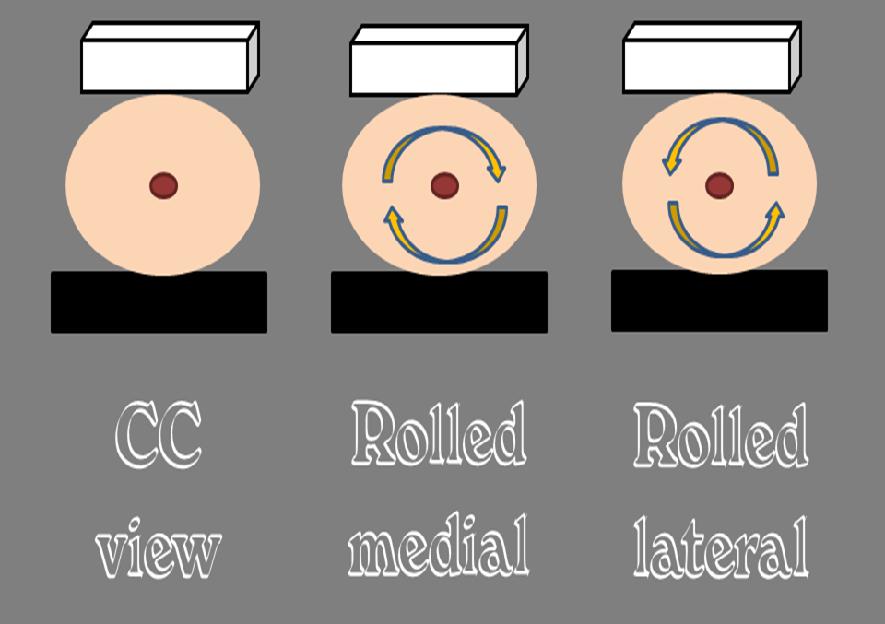

Slide 53
Primary signs of cancer on Mammography
Major Signs:
Stellate mass
Calcification -- Macro or Micro – calcification - which has charctersotc suspicion for malignancy
Breast Density
Localized stromal distortion or asymmetry of parenchyma with out previous surgery
Minor Signs:
Skin and nipple changes
Changes in vascularity
Asymmetry of the duct pattern particularly affecting one segment
Enlarged , dense Axillary lymph nodes

Slide 54
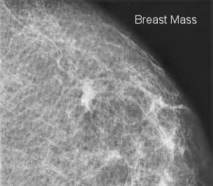
The mass itself is typically then described according to three features
the shape or contour
the margin
the density.
shape, if it is round, oval, or slightly lobular, the mass is probably benign.
If the mass has a multi-lobular contour, or an irregular shape, then it is suggestive of malignancy. ‘
Margin‘ refers to the characteristics of the border of the mass image. When the margin is circumscribed and well-defined the mass is probably benign.
If the margin is obscured more than 75% by adjacent tissue, it is moderately suspicious of malignancy..

Slide 55
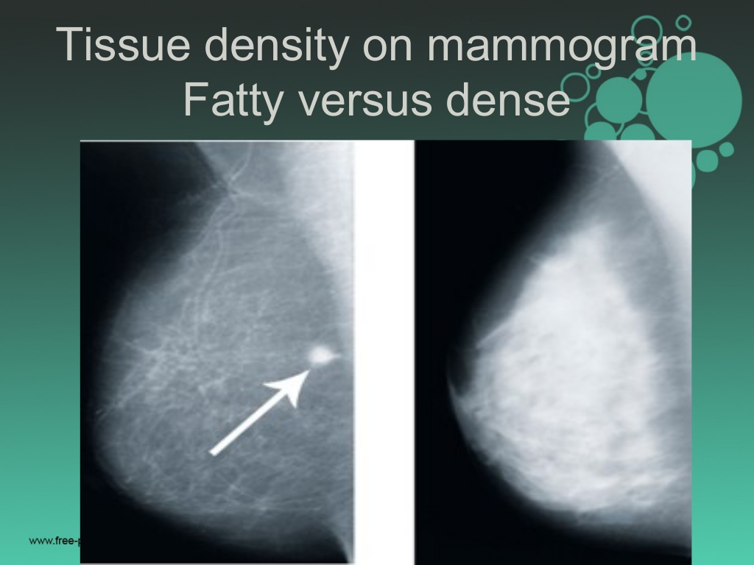
Breast density is based on
: how much fibrous and glandular tissue
: how is the distribution within the breast tissue
: How is breast made up of fatty tissure
Density‘ is usually classified as either fatty, low, iso-dense, or high. The mass is probably benign for fatty and low densities
moderately suspicious of malignancy for an iso-density, and highly suspicious of malignancy at high densities
Dense breasts are not abnormal but thety are linked to higher risk of breast cancer

Slide 57
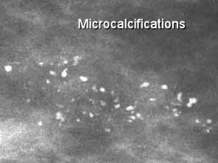
Microcalcifications
Microcalcifications are on of the main ways breast cancer is mammographically detected when it is in the very early stages.(DCIS)
Microcalcifications are actually tiny specks of mineral deposits (such as calcium) They can be distributed in various ways.
Sometimes microcalcifications are found scattered throughout the breast tissue, and they often occur in clusters.
Most of the time, microcalcification deposits are due to benign causes. However, certain features and presentations of microcalcifications are more likely to be associated with malignant breast cancer.

Slide 58
Benign and malignant indicators for micro calcifications
 |  | Benign/probably benign | suspicious/malignant
Morphology | Popcorn egg shell with a dense center | x (adenofibroma)
 | curvilinear egg shell with a clear center | x (calcified cyst, cytosteatonecrosis)
 | intra and peri-ductal bilateral | x (secretory disease)
 | smudgy on CC and fluid level on lateral | x (milk of calcium)
 | powderish/BIRADS: amourphous,indistint |  | x
 | crushed stone/BIRADS: pleomorphic, heterogeneous |  | x
 | casting/BIRADS:linear, branching |  | x
Distribution | diffuse, scattered | x
 | regional | x
 | segmental/within a major system, wedge shaped, nipple oriented |  | x
 | clustered/usually grouped in less than 2 cubic centimetres |  | x
 | linear, branching within the galactophores |  | x
Density | homogeneous | x
 | heterogenous |  | x
Size and number | size in mm | x ( >1 ) | x ( < 0.2 to 1 )
 | number per cubic centimetre | x ( < 3.5 ) | x ( > 3-5 )

Slide 59
If the microcalcifications are
‘Powderish’, with either a fine, indescernible, or ‘cotton ball’ appearance, then the probability of DCIS is about 47%, and most frequently results in a ‘low-grade’ cancer.
Crushed Stone’ characteristic, appearing either as coarse, granular, angular, broken-needle-tip, arrowhead, or a spearhead shape, then the probability of DCIS is about 61%, the breast cancer classified as low to intermediate-grade.
Casting’ appearance, then the probability of DCIS is about 96%, the breast cancer classified as high-grade.
Casting microcalcifications typically appear in two variations.
Variant A is called ‘dense casting, with linear and branched, fragmented, or irregular features.
Variant B is called ‘dotted casting’, with granular and branched, dotted, or snakeskin-like features.

Slide 60
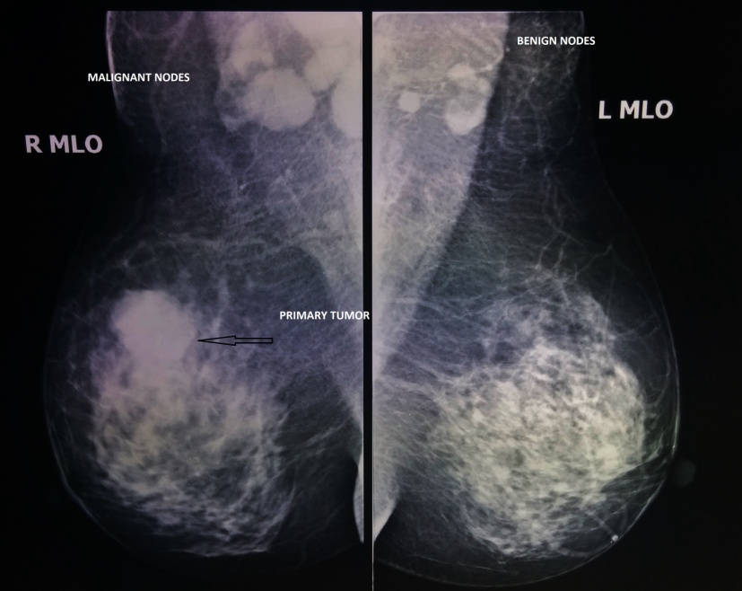
An axillary lymph node that seems enlarged on a mammogram could contain cancer
However, mammographical features of benign and malignant lymphadenopathy are quite often indistinguishable.
Sometimes the presence of intranodal calcifications can be more suggestive of malignancy as well.
As a rule of thumb, an axillary lymph node is suspicious if its size is greater than 2 cm and with no fatty hilum.
More precicely, when a lymph node has a fatty hilum visible, the outer cortex should be 5 millimeters thick at most, and usually less.
When the cortex is 6mm or thicker, chances of cancer spread into the lymph node are significant.

Slide 61
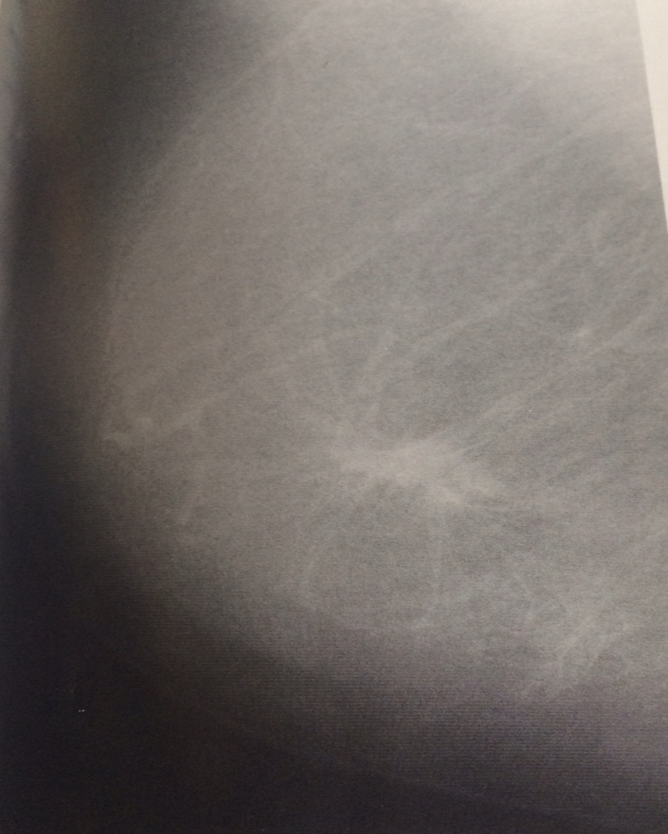
Mass with extensive spiculated margins

Slide 62
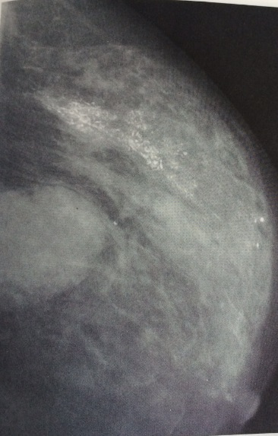
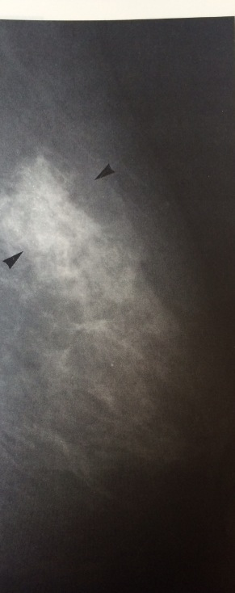
Malignant calcification , increased parenchymal density
Reticular calcification in intraductal cancer

Slide 63
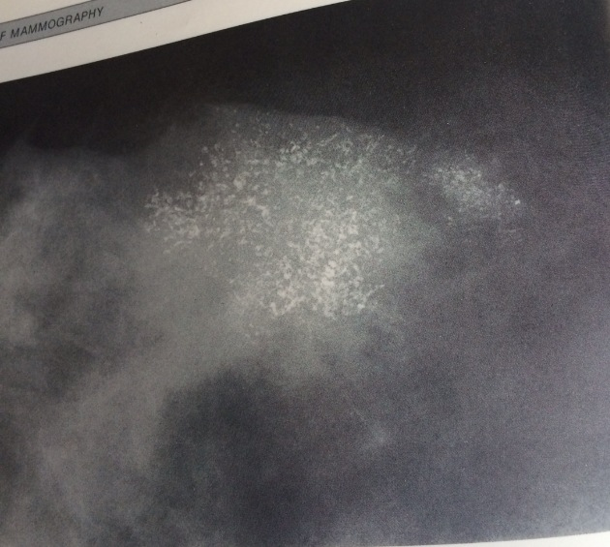
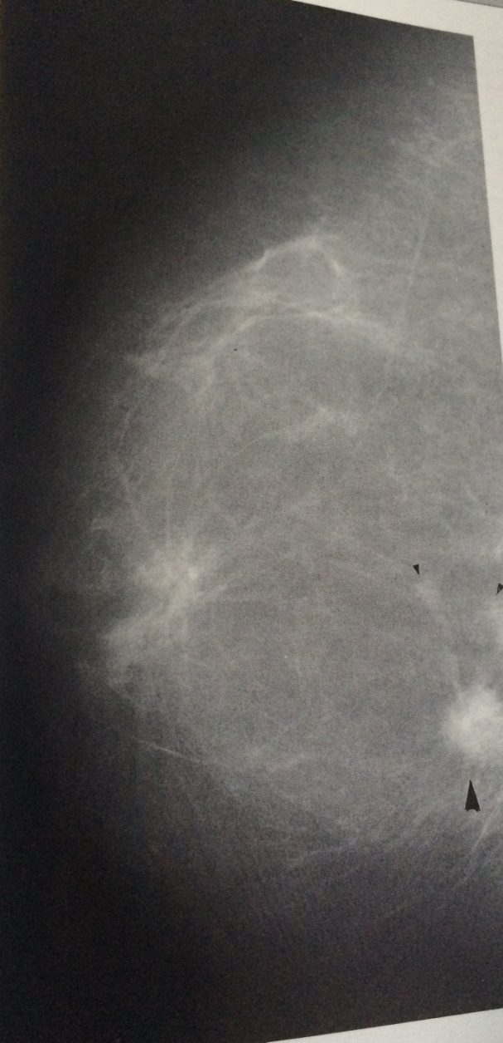
Multifocal carcinoma
Extensive branching ,coalescent calcification

Slide 64
Mammographic features of benign lesions
Outline and shapes
well defined s masses are usually fibro adenoma in young breast or cyst in peri menopausal women
Well circumscribed borders
Halo sign : complete and partial ring surrounding the periphery of a breast mass
A lesion containing material of fat density has high probability of benign lesion
such as lipoma, traumatic oil cyst
In general benign lesion are of low density

Slide 65
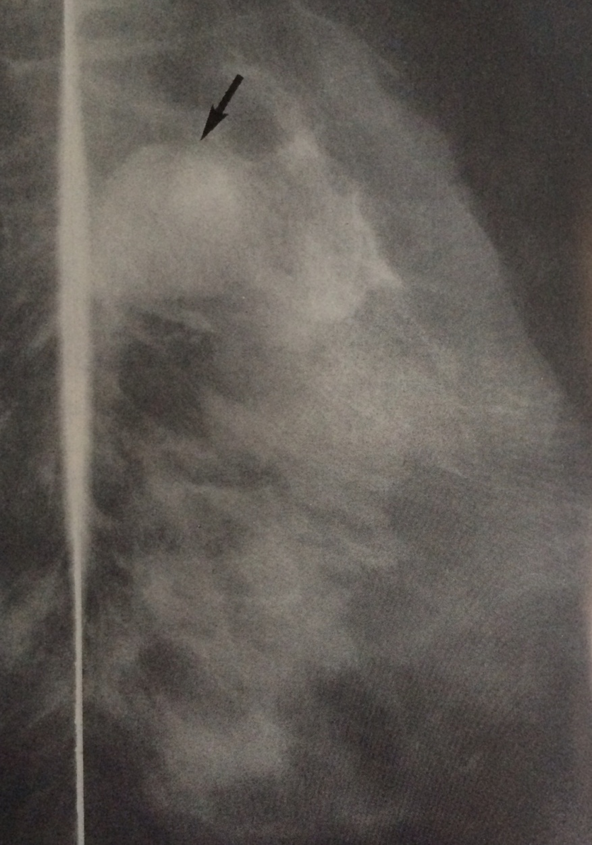
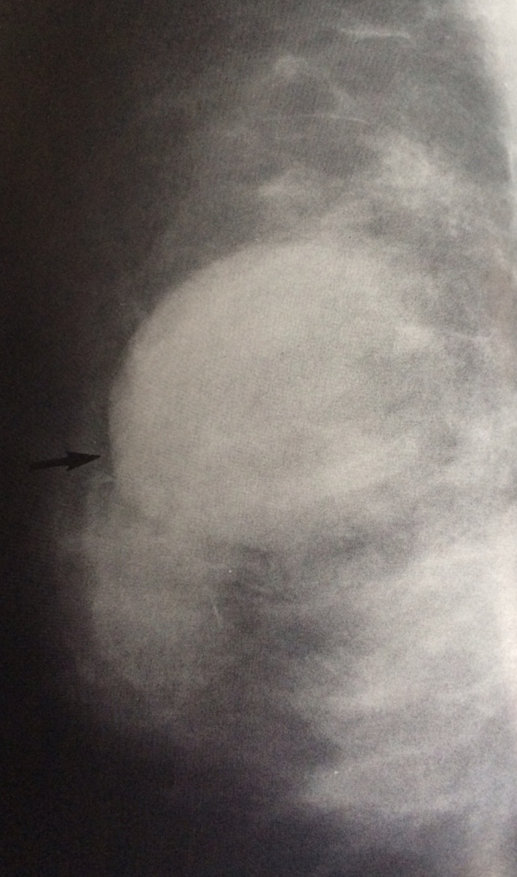
Fibroadenoma
Cyst with Halo sign

Slide 66
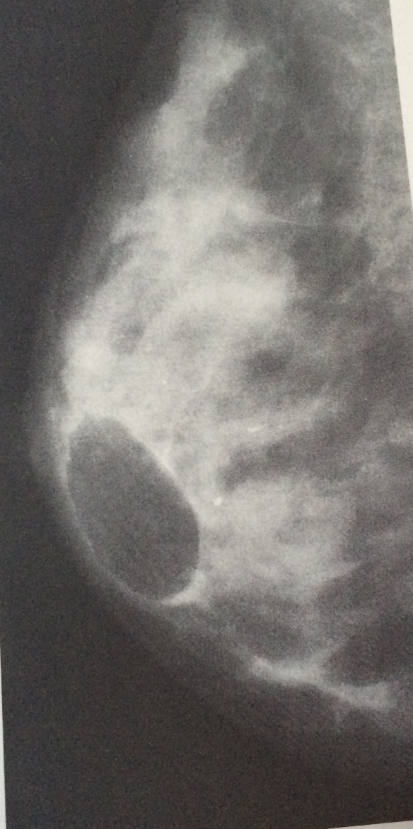
Well defined , homogenous lesion -- Lipoma

Slide 67
Magnetic resonance imaging (MRI)
High-resolution contrast-enhanced MRI has recently emerged as a sensitive imaging modality for the detection of breast cancer.
The high sensitivity, which approaches 98%, makes MRI useful in specific clinical situations,
Evaluating patients with breast implants
detecting local recurrence
After breast-conserving therapy,
detecting multifocal/multicentric disease.
MRI avoids exposure to radiation,
Technique is cumbersome and expensive, not readily available,
Does not detect microcalcifications
However, the moderately low specificity of 47 - 67% requires
Computed tomography (CT) scanning
This modality has no established place in the evaluation of palpable breast masses.

Slide 74
