Slide 1
How to DO: LAPAROSCOPIC SPLENECTOMY
Liverpool Hospital
Monday Morning Registrar Teaching Session
Dr Gratian Punch
13 April 2015

Slide 2
Scope of the Session
PLEASE NOTE:
THIS SESSION IS FOR ELECTIVE LAPAROSCOPIC SPLENECTOMY ONLY.
THERE IS LITTLE TO NO PLACE FOR LAP SPLEEN IN TRAUMA.
PLEASE REVIEW OPEN SPLENECTOMY IN YOUR OWN TIME.
REMEMBER – ALWAYS MORE THAN ONE WAY TO SKIN A CAT
LAP SPLENECTOMY
Suggested reading and references
Indications
Contraindications
Informed Consent
Pre-operative Vaccination
The Procedure in 4 steps
Post Operative Care + Potential Complications
Tips
Final Questions

Slide 3
Suggested reading and references
RACS – GSA NSW Presentation:
Spleen, Lymphatic and Hypertension
Author: Dr Marthe Chehade
Date: 06 Sep 2014
Presented at Johnson & Johnson, Macquarie Park NSW, September 6 2014.
(found at www.generalsurgeons.com.au, educational webcast, 2014, NSW.
Sabiston Textbook of Surgery, 19th Ed, Townsend et al. Copyright © 2012
Current Procedures: Surgery. Rebecca M. Minter, Gerard M. Doherty. Copyright © 2010 by The McGraw-Hill Companies, Inc. All rights reserved.
The Australian Immunisation Handbook 10th Edition 2013 (updated January 2014)

Slide 4
LAP SPLEnectomy - Indications
Splenic cysts or splenic mass
Splenic abscess
Hematologic disorders:
Idiopathic thrombocytopenic purpura.
Hemolytic anemia.
Hereditary spherocytosis.
Other hereditary or autoimmune anemias.
Severe hypersplenism.
Perisplenic malignancy.
Splenic artery aneurysm.
Splenic vein thrombosis with left-sided portal hypertension.

Slide 5
Contraindications
Portal hypertension due to liver disease.
Thrombocytopenia is not a contraindication of splenectomy.
Although preoperative transfusion is not recommended, intraoperative transfusion may be required should coagulopathic bleeding occur.

Slide 6
Informed consent
Expected Benefits
Cessation or prevention of life-threatening hemorrhage.
Treatment of hematologic disorders, malignancy, or symptomatic mass or hypersplenism.
Potential Risks
Post-splenectomy sepsis.
Bleeding.
Infection (wound or intra-abdominal abscess).
Pancreatitis or pancreatic leak.
Damage to surrounding structures (stomach, diaphragm, colon, etc).
Recurrence of primary disease (thrombocytopenia, etc).

Slide 7
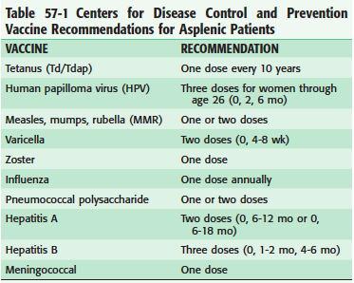
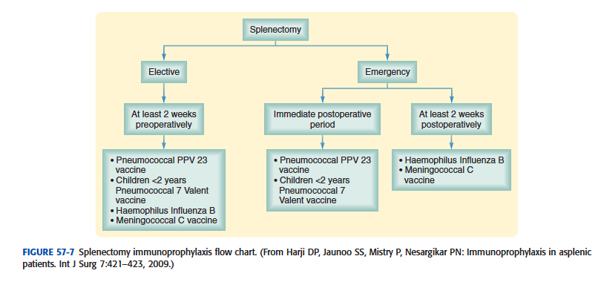
Pre operative vaccination
Suggested reference :
Australian Immunisation Handbook 10th edition 2013 – can be found free: http://www.health.gov.au/internet/immunise/publishing.nsf/Content/Handbook10-home
Pages 161-164 – Guidelines for Asplenic Patients
Sabistons:

Slide 8
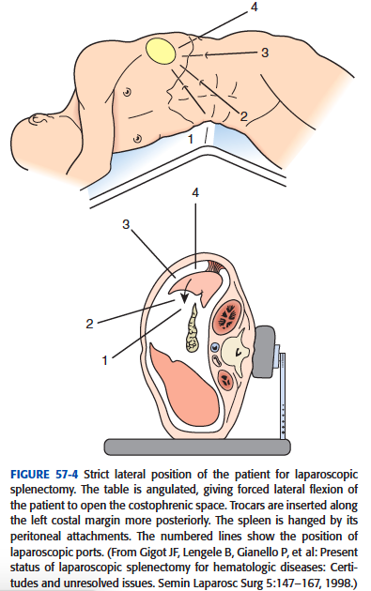
Patient positioning (1/2)
Laparoscopic splenectomy:
Preferentially performed in the right lateral decubitus position
Screen behind patient
Faces towards surgeon
Strapped + taped
Pillow between legs to offload pressure
May also be performed with the patient supine.

Slide 9
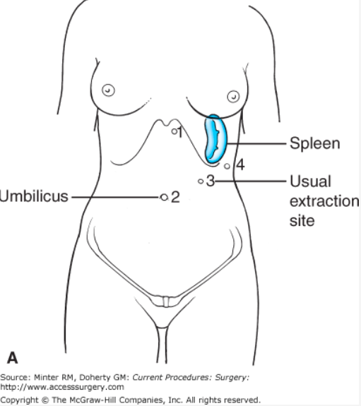
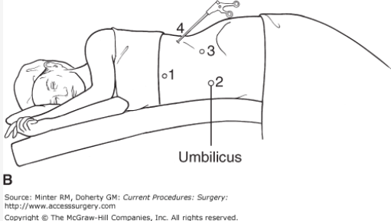
Patient positioning (2/2)
Laparoscopic splenectomy:
Preferentially performed in the right lateral decubitus position
Screen behind patient
Faces towards surgeon
Strapped + taped
Pillow between legs to offload pressure
May also be performed with the patient supine.

Slide 10
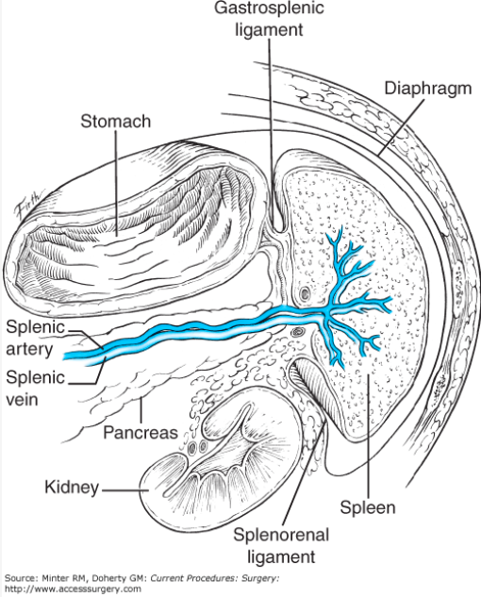
Lap Spleen steps (1A/4)
Gastrosplenic ligament containing short gastric vessels divided to access the splenic vessels
Note: Spleen Ligament anatomy:
2 vascular ligaments
Gastrosplenic = short gastrics
Lieonorenal = Spl A. + V.
2 avascular ligaments
Splenophrenic
Splenocolic

Slide 11
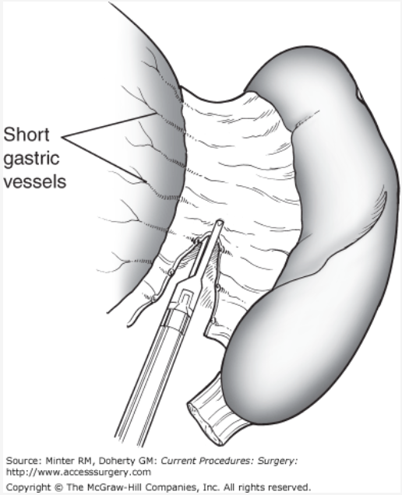
Lap Spleen steps (1b/4)
The gastrosplenic ligament is transected using advanced energy device of choice
So next on view are the splenic vessels.
But first the dissection will be focused to the other ligaments

Slide 12
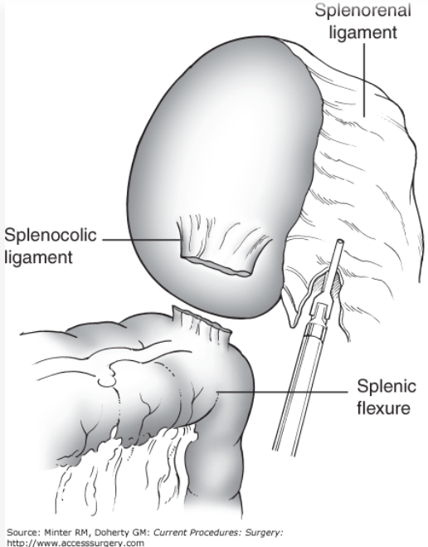
Lap Spleen steps 2/4
The relatively avascular splenocolic and splenorenal ligaments are divided along with the other attachments, freeing the spleen.

Slide 13
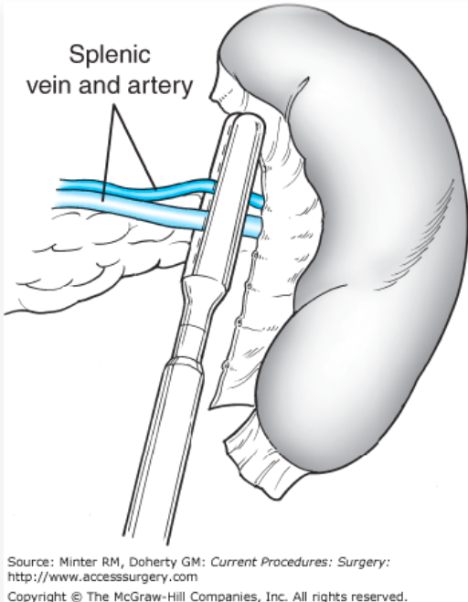
Lap Spleen steps 3/4
Taking the splenic artery and vein:
A vascular stapler is used to divide the splenic artery and vein.
The artery is always divided before the vein.

Slide 14
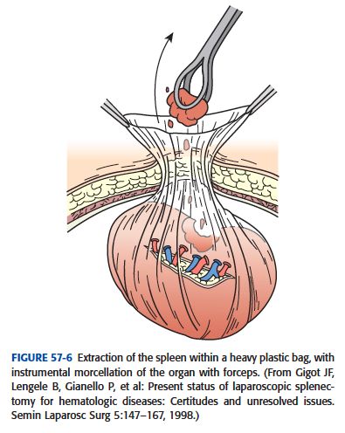
Lap Spleen steps 4/4
Retrieve the specimen is placed into an endoscopic retrieval bag.
Depending on its size, the spleen may require maceration with a ring forceps or finger before it can be removed from the body.
Decide Drain v. no drain
Then closure of the ports

Slide 15
Post op management
Potential complications
Nasogastric decompression – surgeon preference
For 12–36 hours after open splenectomy.
Optional for laparoscopic splenectomy.
Diet is advanced as tolerated after removal of the nasogastric tube.
If the patient has not been vaccinated preoperatively (eg, in cases of splenectomy for trauma or iatrogenic injury), this should be done promptly.
Postoperative bleeding or hemorrhage.
Gastric injury or leak.
Pancreatic injury resulting in pancreatitis or pancreatic leak or fistula.
Thrombocytosis – Aspirinif PLT>1000
Splenic vein thrombosis.
Left lower lobe atelectasis or pneumonia.
Superficial or deep space surgical site infection.
Recurrence of disease (if splenectomy is performed for hematologic disease).

Slide 16
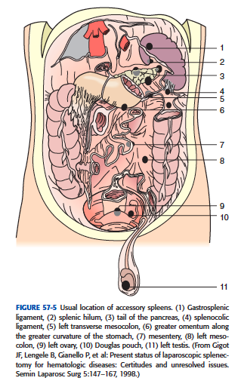
tips
Pre op embolise:
patients with severe hypersplenism - This may reduce intraoperative blood loss.
? Drain:
Difficult/traumatic dissection
Test the drain (Lipse -? Pancreatic Leak)
after the patient resumes a normal diet and before removing the drain.
Educate patient + write to GP
prompt medical evaluation for signs of infection
OPSI etc…
Beware:
the wandering spleen /splenunculus
Don’t leave pieces of spleen inside

Slide 17
Final Questions

Slide 18
Aust. Imm. Handbook:
Pneumococcal, meningococcal, Hib and influenza vaccination are particularly recommended for all persons with asplenia (functional or anatomical)
Other vaccinations should be up todate.
Elective splenectomy - vaccination should be completed 2 weeks before the scheduled operation date.
Children with splenic dysfunction should also be given antibiotic prophylaxis to prevent bacterial infection, until at least 5 years of age.
Asplenic persons + Carers should also be educated about fever (emerg Abx + early review)
Recommended to wear a medical alert.

