Slide 1
Penetrating Neck Injuries
Registrar Teaching
Nick Bull

Slide 2
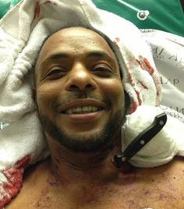
Structure
Penetrating Neck Injuries
Background
Anatomy
Initial Approach
Diagnostic Testing
Operative Management
Take Home Points

Slide 3
Background
‘Tiger Country’
High density of vital organs
Unprotected anatomical region
Mortality
Airway compromise - laryngotracheal injuries or external compression
Sustained haemorrhage - major vessel injury

Slide 4
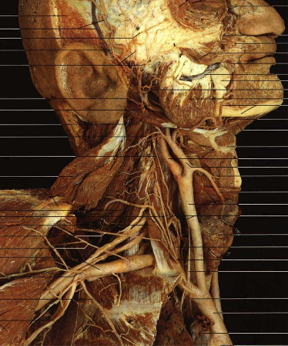
Anatomy - Structures
Respiratory
Vascular
Neurological
Gastrointestinal
Endocrine
Cervical Spine

Slide 5
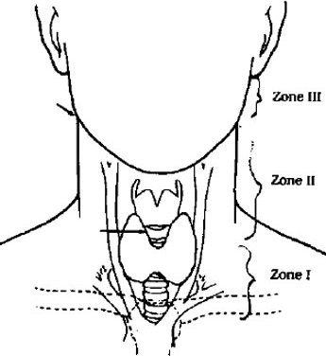
Anatomy - Zones
Zone 1
Clavicles to cricoid
Zone 2
Cricoid to angle of mandible
Zone 3
Angle of mandible to base of skull

Slide 6
Initial Approach
Primary Survey
A - Voice, air exchange, patency, ?C-Spine
ETT vs Surgical airway
B - Breath sounds, chest wall movement
C - Mentation, skin colour, HR, BP, neck veins, haemorrhage
D - Pupils, extremity movement
E - Exposure
Includes initial management and resuscitation
Adjuncts - CXR, EFAST

Slide 7
Initial Approach
Indications for Urgent OT
Severe active bleeding
Hemodynamic instability
Expanding or pulsatile neck hematoma
Massive subcutaneous air
Air bubbling from wound

Slide 8
Initial Approach
Secondary Survey
History
Mechanism and time of injury
LOC/neurology
Blood loss on scene
Examination
Platysmal penetration
Emphysema
Stridor/hoarseness
Bruit/thrill
Neurology inc. CNs

Slide 9
Diagnostic Testing
Indications for imaging
Stable with platysmal penetration - DO NOT PROBE
Dysphonia, dysphagia, odynophagia, hemoptysis, hematemesis, unequal pulses
C-Spine
Options
CT Angiogram +/- oral contrast
Observation
Bronchoscopy/Oesophagoscopy

Slide 10
Operative Management
Positioning
Supine + ETT
Neck extended and rotated opposite to the injury
Earlobe to umbilicus
+/- vein graft site

Slide 11
Approach/Exposure

Slide 12
Approach/Exposure
Pitfalls
Anatomical distortion by expanding haematoma
Need to gain anterior border of SCM
Marginal mandibular branch of facial n. injury
Curve superior part of incision posteriorly
Post-operative haematoma prevention

Slide 13
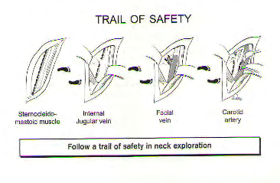
Approach/Exposure

Slide 14
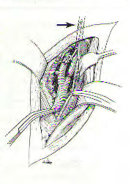
Specific Injuries - Carotids
Proximal control +/- distal control
Virgin territory if able
Common, internal and external
Enter carotid sheath
Protect vagus nerve
Identify periadventitial plane and bluntly dissect away other structures
Protect neurology
Maintain BP when clamping to optimise contralateral support
Comatose or hemodynamically unstable - ?role for ligation vs repair

Slide 15
Specific Injuries
Venous
Ligation is the management of most venous injuries
Unless primary repair is simple…
Esophageal
Approach via same incision or go lateral to carotid sheath
Easier on the left side
NGT used to identify esophagus
Primary repair/drainage/diversion
Often missed injuries, severe morbidity

Slide 16
Specific Injuries
Laryngotracheal
Tracheostomy should not be placed through injured segment if able
Always absorbable sutures
Involve ENT early
Manage complications
Delayed reconstruction

Slide 17
Take Home Points
ATLS principles
Consider airway, vascular and neurological injury
Anatomical exposure to reduce iatrogenic injuries
Pre-operative assessment and planning where able

Slide 18
References
Top Knife
Trauma Manual - trauma and acute care surgery
Mastery of Surgery
Rohan’s colour atlas of anatomy
Google images

