Slide 1
Gallbladder Cancer

Slide 2
Introduction
Uncommon but fatal
Majority found incidentally
Vague non specific symptoms
More common in south america
Female gender bias
Age over 65

Slide 3
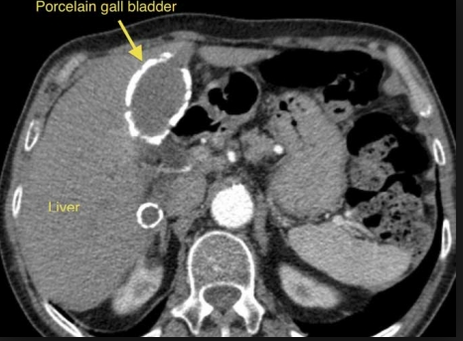
Risk Factors
Gallstone disease: - present in 70 – 90% patients with GBC - history GS strongest risk factors - despite risk – overall GBC in pts with stones – 0.5 – 3 %
Porcelain gallbladder – intramural calcification of GB wall - associated with cholelithiasis in 95% - GBC reported between 0-60%
GB polyps - outgrowths of GB mucosa, found incidentally - classified as benign or malignant
Primary sclerosing cholangitis - Gb mass reported in chronic inflammatory state - study – 286 pts – 6% GB masses of which 56% BGC

Slide 4
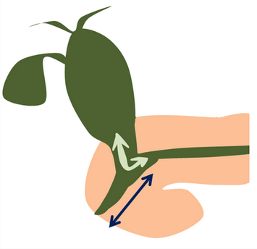
Risk Factors cont
Salmonella – association between chronic carriage and GBC
Helicobacter – implicated based on H derived cytotoxins – further clarification needed
Congenital biliary cysts – associated more with cholangiocarcinoma - incidence of malignancy increases with age
Abnormal pncreaticobilary duct junction - pancreatic duct drains in CBD, predisposes to reflux of pancreatic juice - GBC common therefore cholecystectomy recommended - younger age, less female gender, lower association with stones

Slide 5
Molecular pathology
Hypothesized chronic irritation of GB mucosa predispose to malignant transformation
Histologic and molecular differences: - Japan – K-ras mutations and late onset p53 mutation - Chile – K-ras rare, p53 mutations arise early
Adenocarcinoma – progress from dysplasia, carcinoma in situ then invasive cancer

Slide 6
Clinical Presentation
Present 4 ways
1- malignancy suspected pre-operatively because of symptoms: - pain, anorexia, nausea, vomiting, malaise, weight loss, jaundice
2- malignancy found incidentally on radiologic examination
3- malignancy found intra-operatively at the time of cholecystectomy for presumed benign disease
4- malignancy diagnosed incidentally on pathology examination after simple cholecystectomy

Slide 7
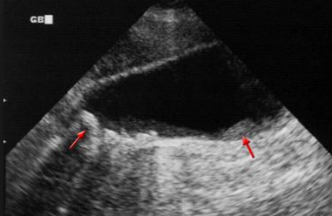
Diagnostic Evaluation
Ultrasound – mural thickening or calcification - mass protruding into the lumen - fixed mass in GB - loss of interface between GB and liver - polyps > 1cm more likely contain invasive cancer
EUS - useful differential diagnosis GB polyp and in staging - EUC v US – 97 v 76% more correct in predicting diagnosis
CT- GBC appear as polypoid mass, focal or diffuse thickening of GB wall, liver invasion, mets
MRI – differentiate benign and malignant, visualise invasion , portal vein encasement, lymph node involvement
PET – main utility to identify advanced disease to avoid unnecessary surgery

Slide 8
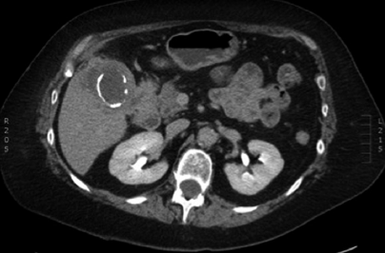

Slide 10
Surgery

Slide 11
Surgery
Surgery only potentially curative therapy
Stage O, I, II – potentially resectable
Stage III – usually have vascular involvement or involvement multiple adjacent organs – resection may be possible
Stage IV - unresectable

Slide 12
General Approach
Diagnostic lap - exclude intra-abdominal disease
Laparotomy – cholecystectomy, resection of adherent involved adjacent organs may be necessary
Specimen sent for frozen section – to achieve negative margins
Cholecystectomy V extended cholecystectomy - decision based on tumour staging
T1 – cholecystectomy
T1b – extended cholecystectomy - controversial – 2 retrospective studies no significant difference overall survival between chole v extended – 87% 10 year survival - 2 reports – 50-60% locoregional recurrence after chole alone

Slide 13
T2
Extended cholecystectomy
Study 6 major hepatobiliary centers - residual disease found 57% patients at any site post extended cholecystectomy
Recommended to re-explore and further resections once detected
1 reports suggests that for GBC to be considered node negative – at least 6 nodes need to be removed

Slide 14
Resectable T3/4 or node positive GBC
In past reluctance to operate due to poor prognosis
Support for radical surgery increasing
Extensive resection involves hepatectomy, pancreaticoduodenectomy, colectomy +- nephrectomy
Median survival = 17 months
15-18% mortality
48-54% morbidity

Slide 15
Palliative procedures
Pts with unresectable GBC may develop jaundice, abdominal pain, symptoms of biliary obstruction
Choice of palliation depends on nature of obstructive symptoms - simple cholecystectomy - endoscopic or percutaneous biliary drainage - Endoscopic stenting or intestinal bypass - biliary bypass – many pts fail this procedure

Slide 16
Overall outcomes
Resection morbidity range 5-54%
Resection mortality range 0-21%
Most common complication – bleeding, bile leak , abscess
Nonspecific symptoms and advanced stage of disease at presentation = poor outcomes
Fewer then 10% of pts who present have T1 tumours
5 year survival – 5-12%

Slide 17
The end

